Slide 1
WebDewey Number Building
Basics
November 2012

Slide 2
Overall workflow
Find starting number/span with add instruction, else find base number
Click Start/Add
System displays notation specified by add instruction or displays Table 1 (in final step)
As needed, user navigates to next number/span with add instruction or base number
Number building complete?
No
Yes
Verify the number is correct, click Save
User term box appears, select user terms
Edit term, click Update
User term needs to be changed?
Yes
Additional term needed?
No
No
Yes
Create additional term, click Add
Select term to set as caption
Save as institutional or personal visibility
Verify presence in the hierarchy
Contribute to Dewey Editors (optional)
If not contributed to Dewey Editors, new number visible only to institution or person

Slide 3
Example 1
Create a new number for Cartoon guide to shorthair cats
Start with the base number
Add standard subdivision
Add user terms
Save for institutional or personal use and contribute to Dewey editors (Optional)

Slide 4
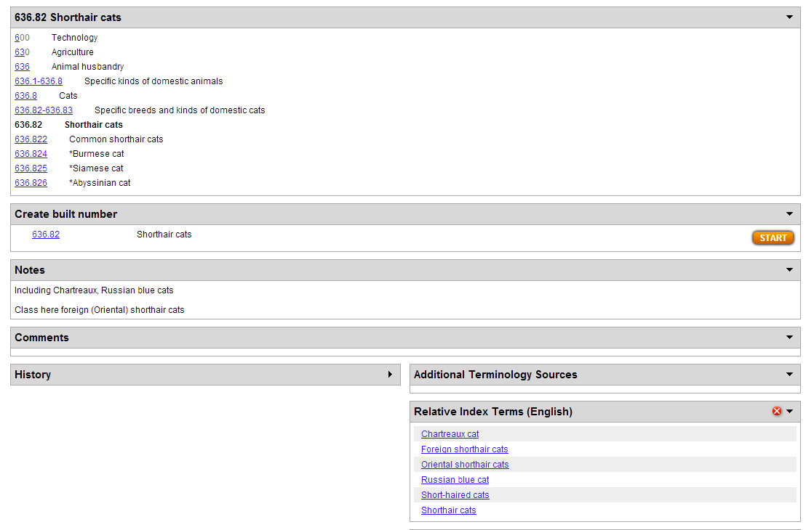
Select base number
Click Start in the “Create built number” box

Slide 5
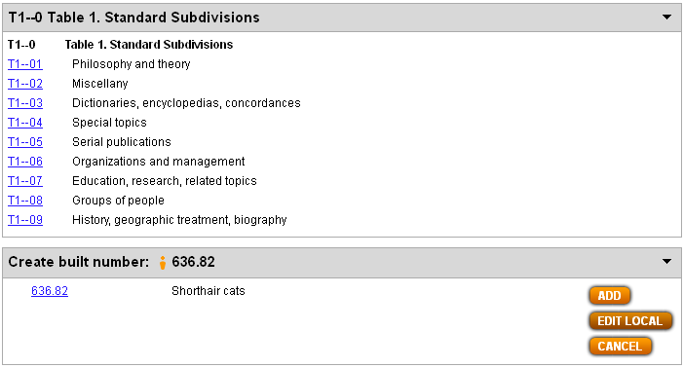
Results of Start action (1)

Slide 6
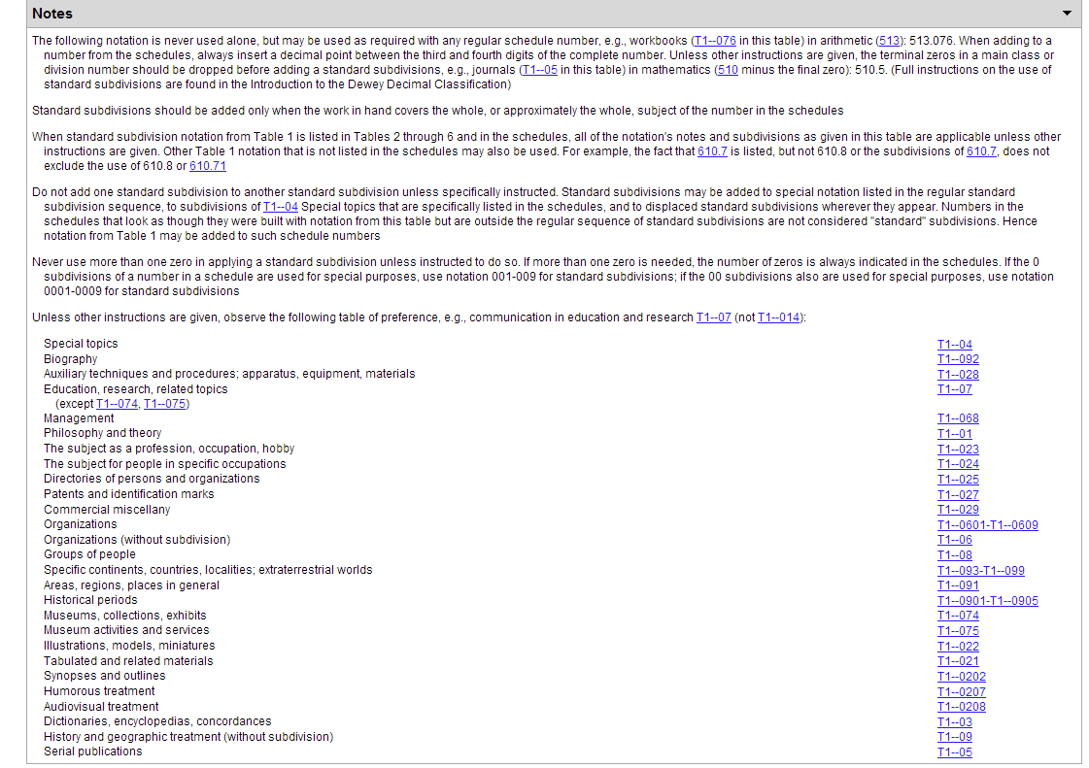
Results of Start action (2)

Slide 7
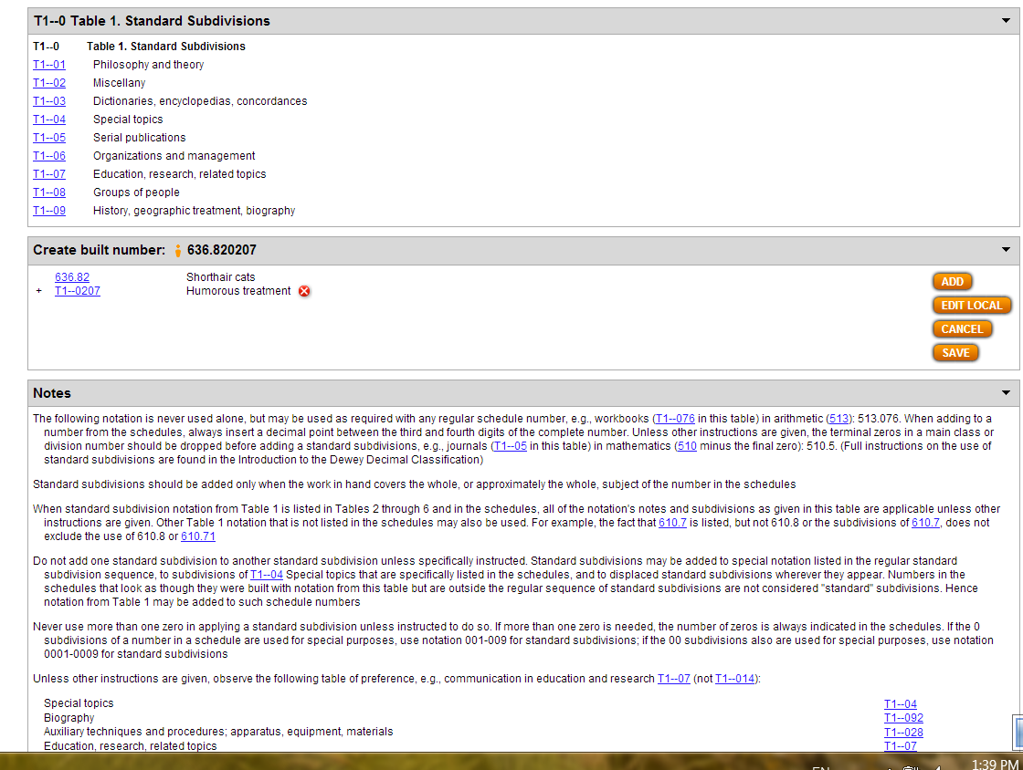
Select standard subdivision T1—0207
Click Add
See results

Slide 8
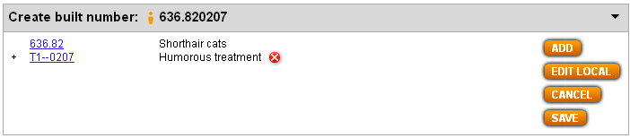
Results of Save (1)

Slide 9
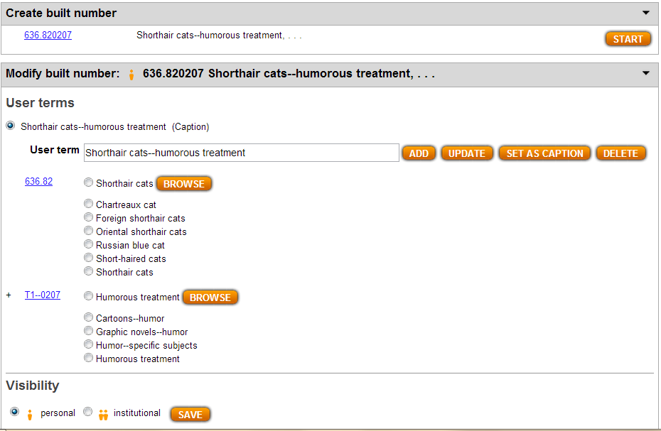
Results of Save (2)
User term populated
Can Save in “Visibility” box personal/institutional

Slide 10
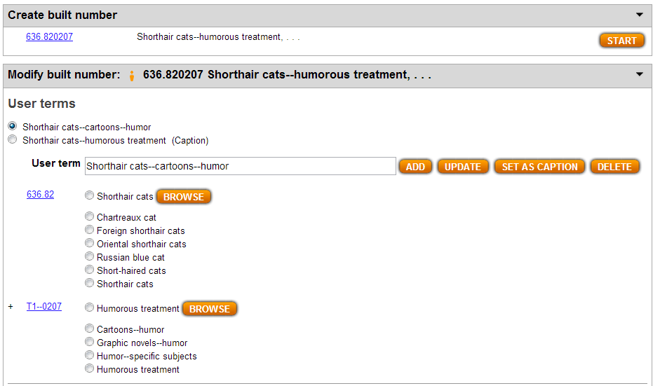
Select additional “User terms”
Click Add to create set chosen

Slide 11
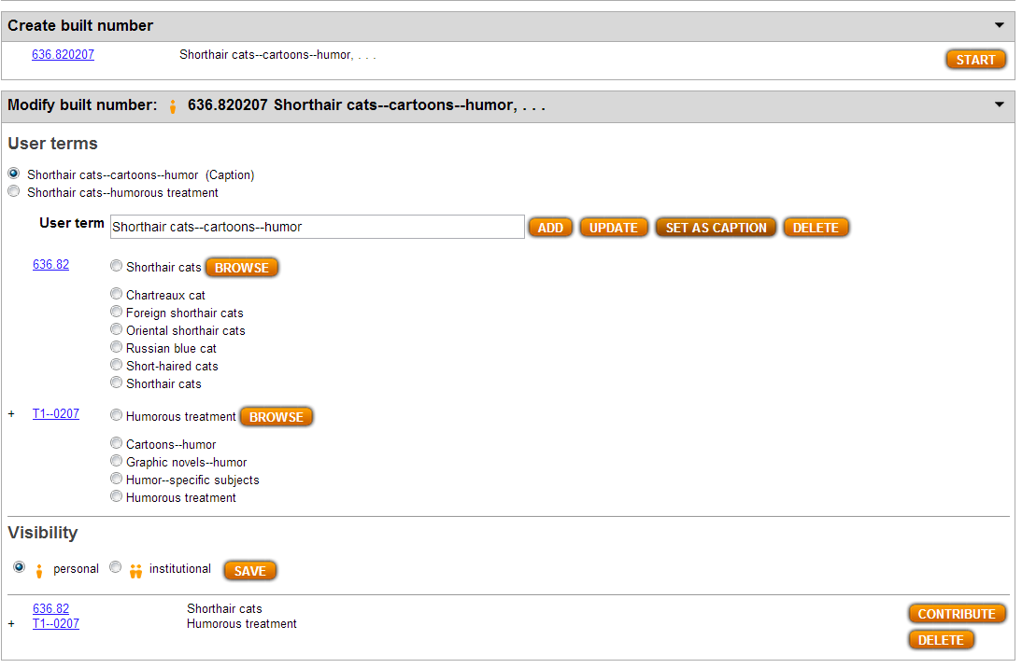
Results from Save action
New terms selected as caption
Personal visibility

Slide 12
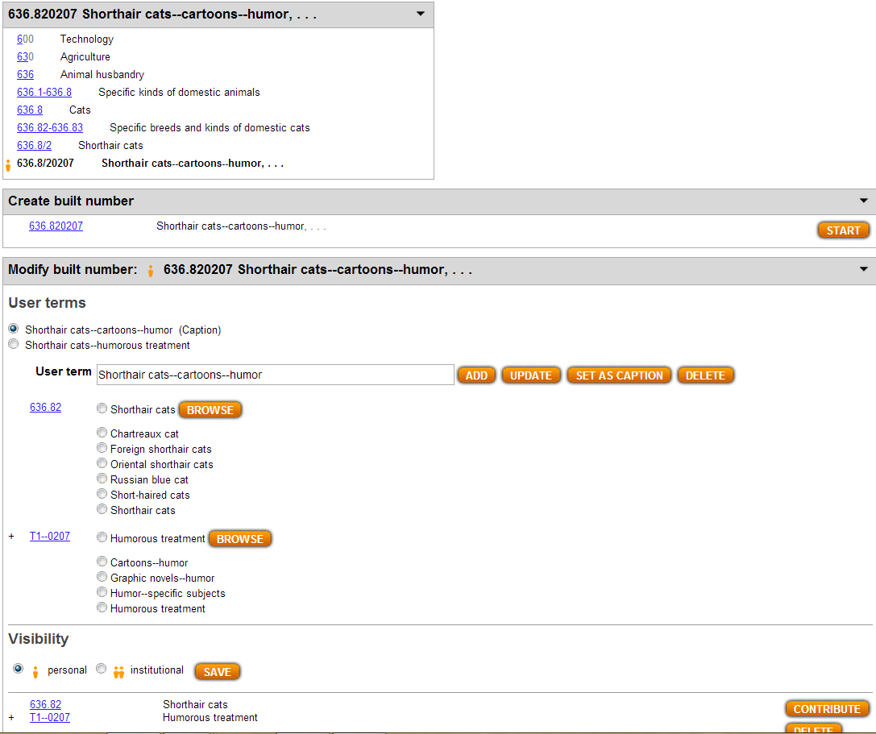
Can be contributed to Dewey Editors
Note placement in hierarchy

Slide 13
Process of building 636.820207 & adding terms
Action | Click | Number built so far | Caption of last number/notation added
Go to 636.82 | Start | 636.82 | Shorthair cats
Go to T1—0207 | Add | 636.820207 | Humorous treatment
Result 636.820207 | Save | 636.820207 | Shorthair cats—humorous treatment
Select user terms | Add | 636.820207 | Shorthair cats—cartoons—humor
Set as caption | Set as caption | 636.820207 | Shorthair cats—cartoons—humor

Slide 14
Example 2
Create a new number for labor economics in Peru
Start with the base number
Add standard subdivision
Add user terms
Save for institutional or personal use and contribute to Dewey editors

Slide 15
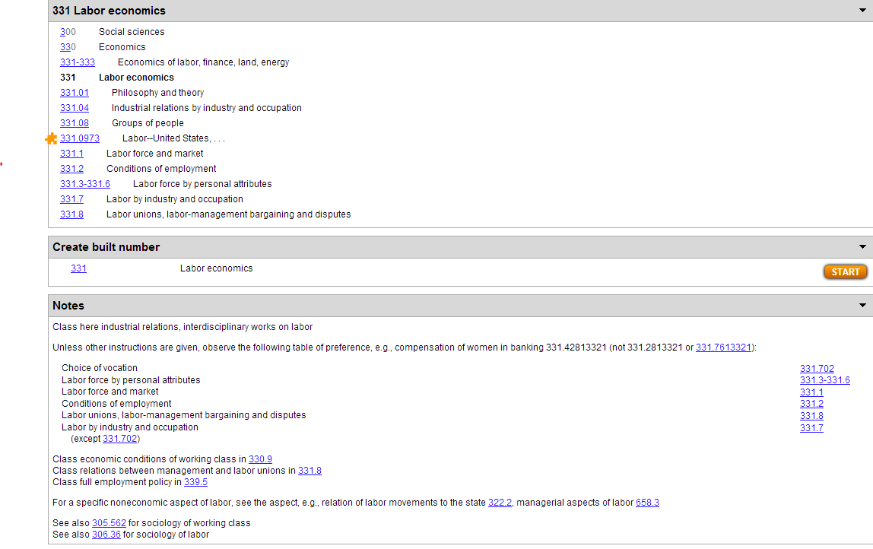
Select base number
Click Start in the “Create built number” box

Slide 16
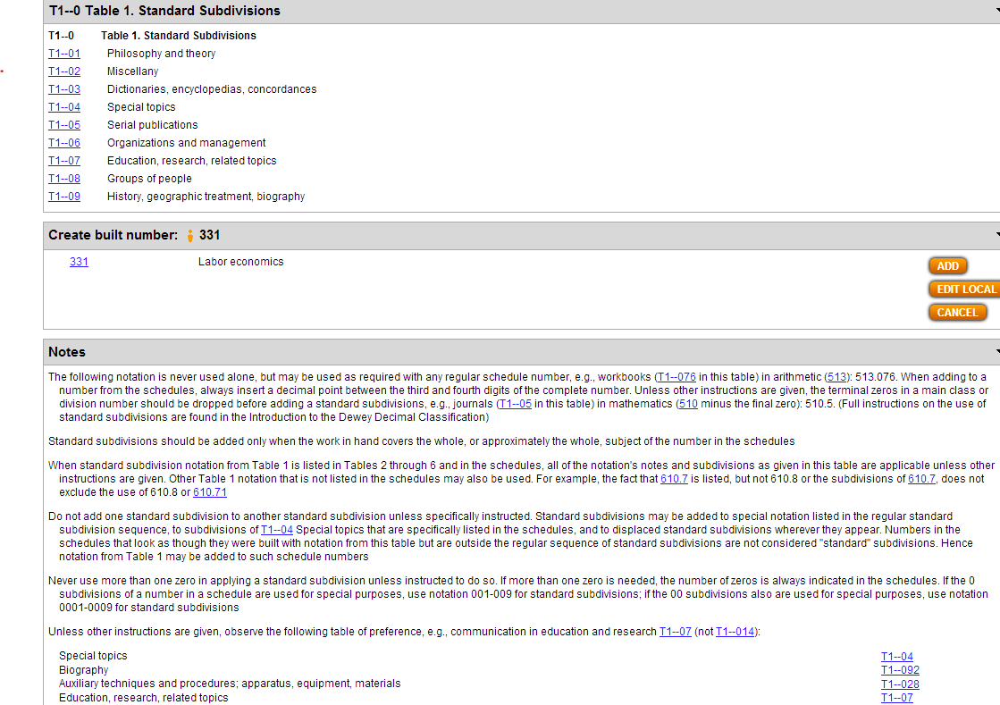
Results of Start action (1)
Standard subdivisions displayed

Slide 17
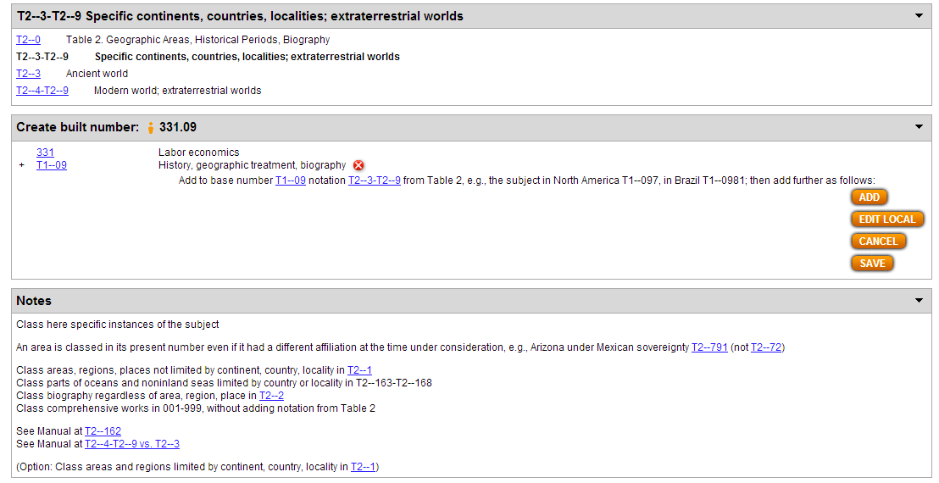
Select standard subdivision T1—093-T1—099
Click Add
See results

Slide 18
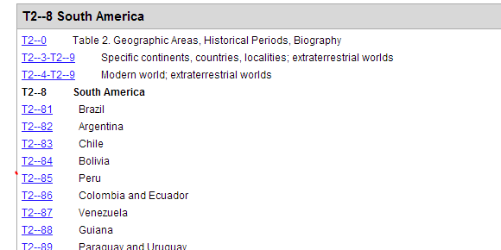
Results from hierarchy
Click on country

Slide 19
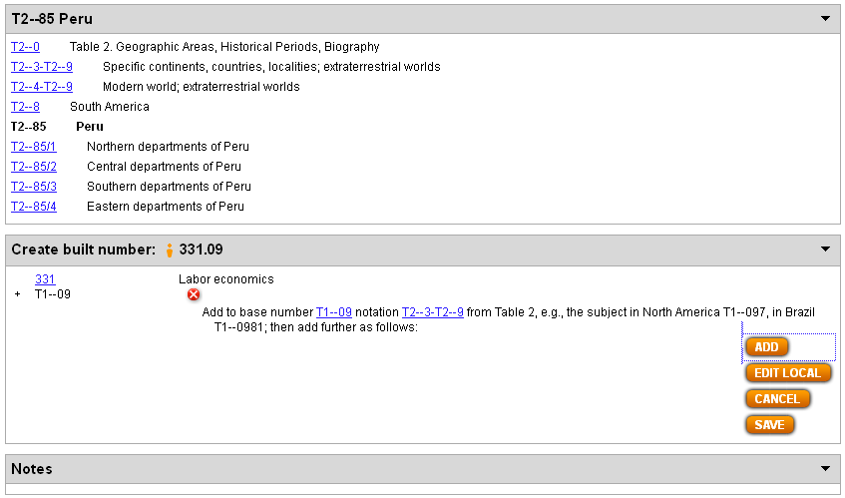
Select country
Click Add

Slide 20
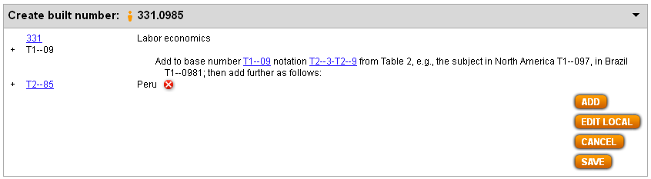
Results screen
Click Save

Slide 21
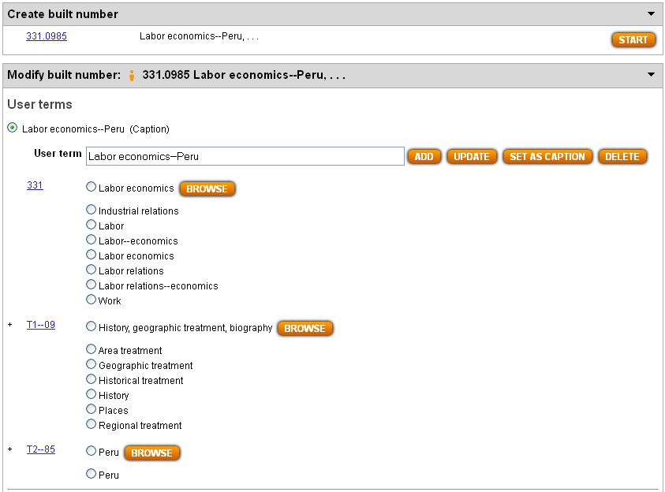
Results screen from Save
Note default “User terms”

Slide 22
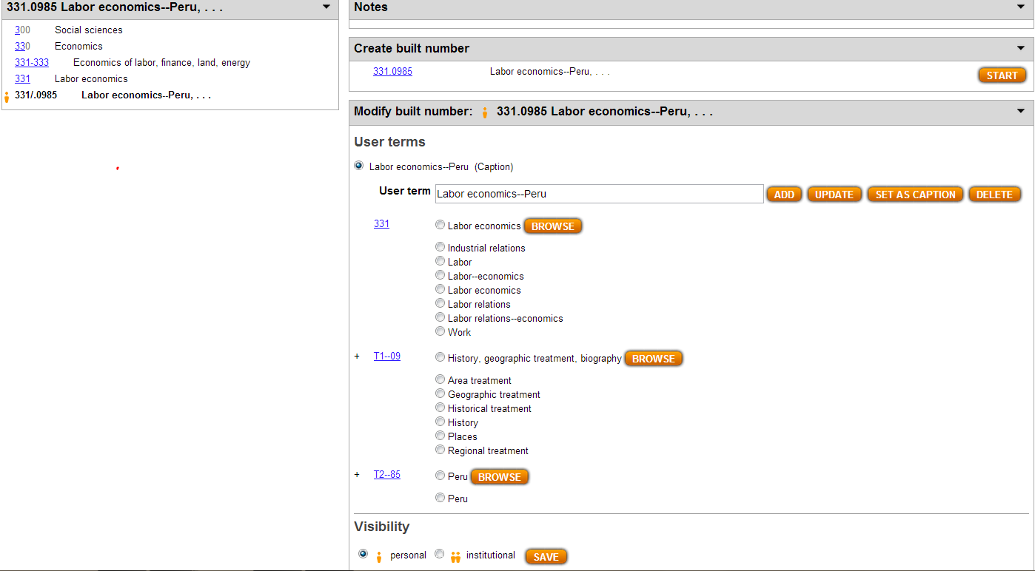
Results from Save action
Personal visibility

Slide 23
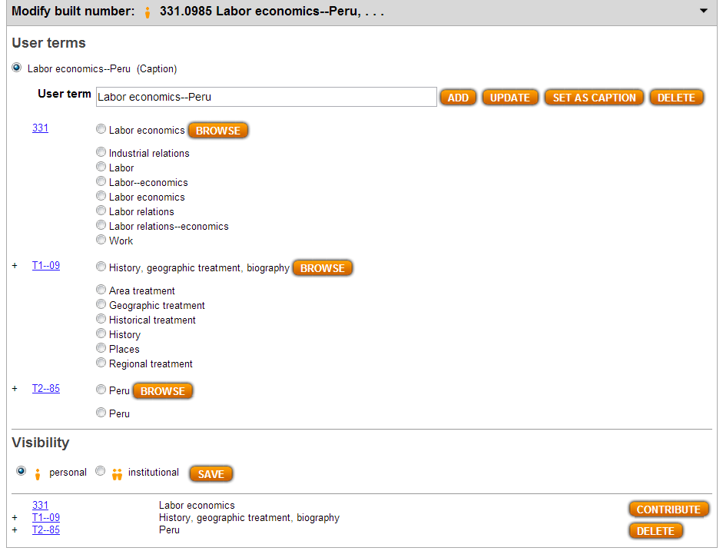
Can be contributed to Dewey Editors

Slide 24
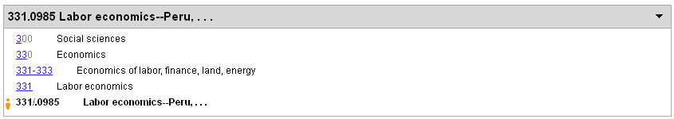
Note placement in hierarchy

Slide 25
Example 3
Create a new number for directories of College sports in the Canada
Start with the base number
Add standard subdivision
Add /edit user terms
Save for institutional or personal use and contribute to Dewey editors

Slide 26
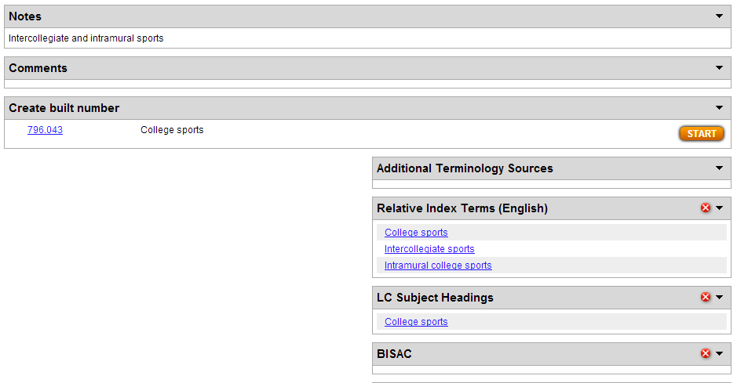
Select base number
Click Start in the “Create built number” box

Slide 27
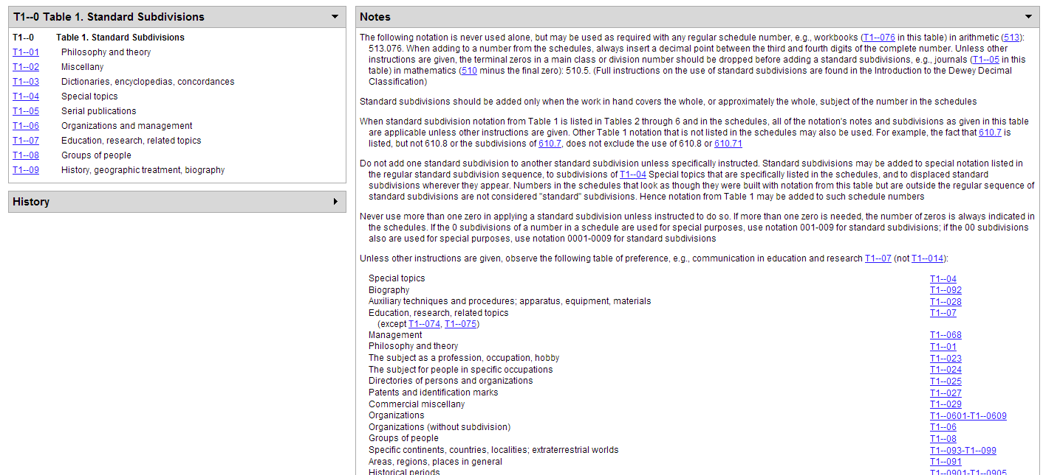
Results of Start action (1)

Slide 28
Results of Start (2)

Slide 29
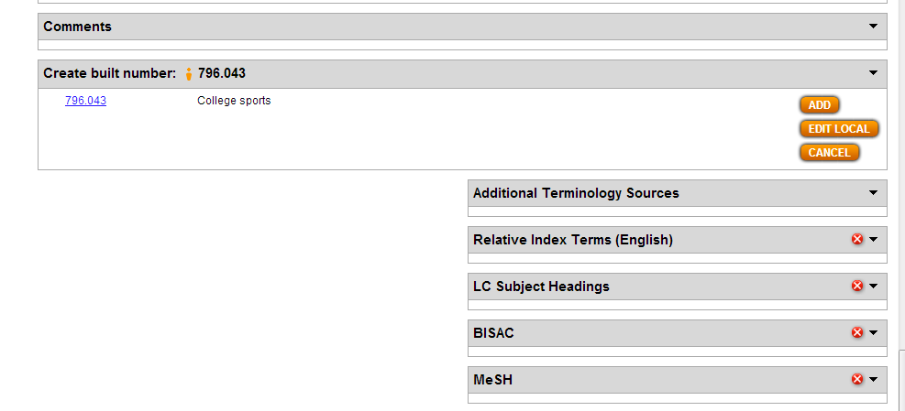
Results of Start (3)

Slide 30
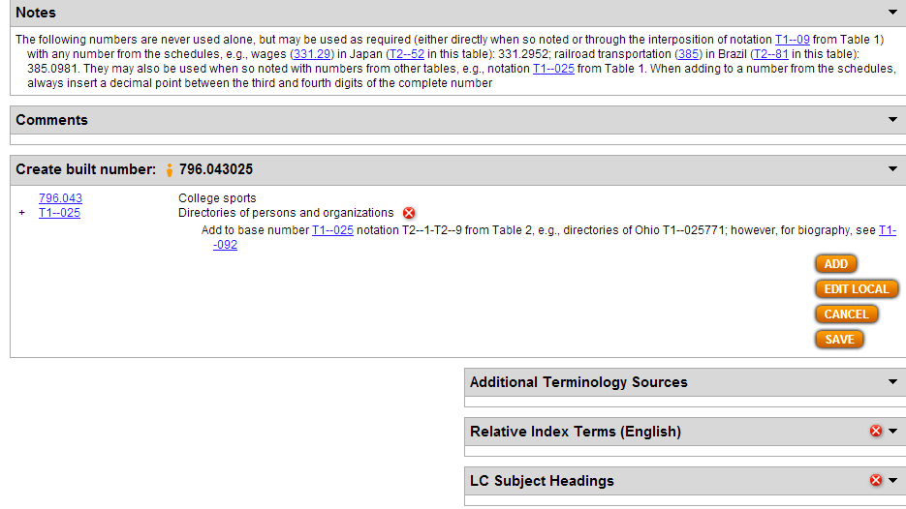
Select standard subdivision T1—025
Click Add
See results

Slide 31
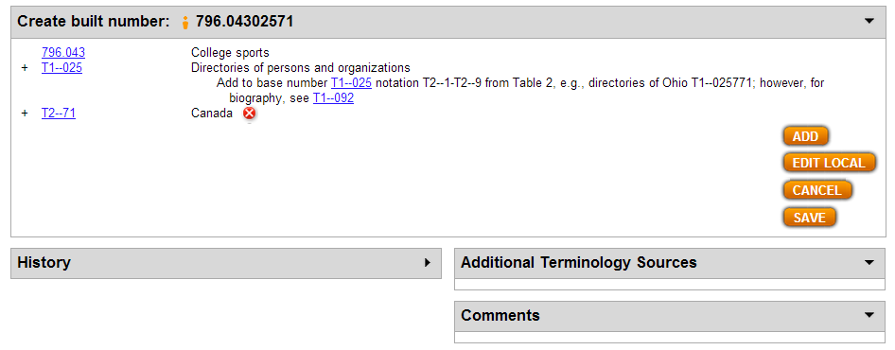
Select Canada from T2
Click Add
Results from Add

Slide 32
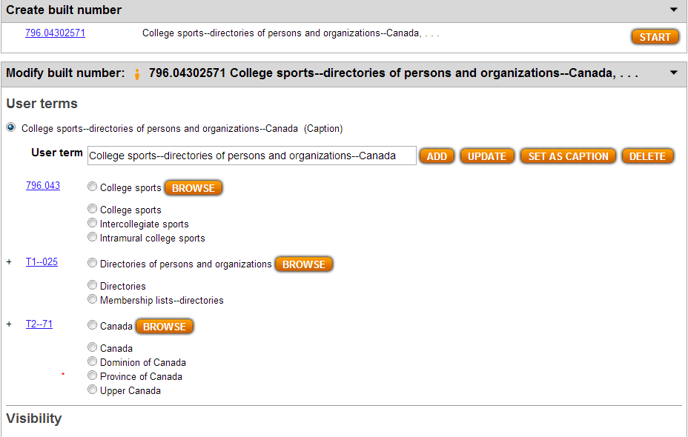
Click Save
Results from Save
Note default terms

Slide 33
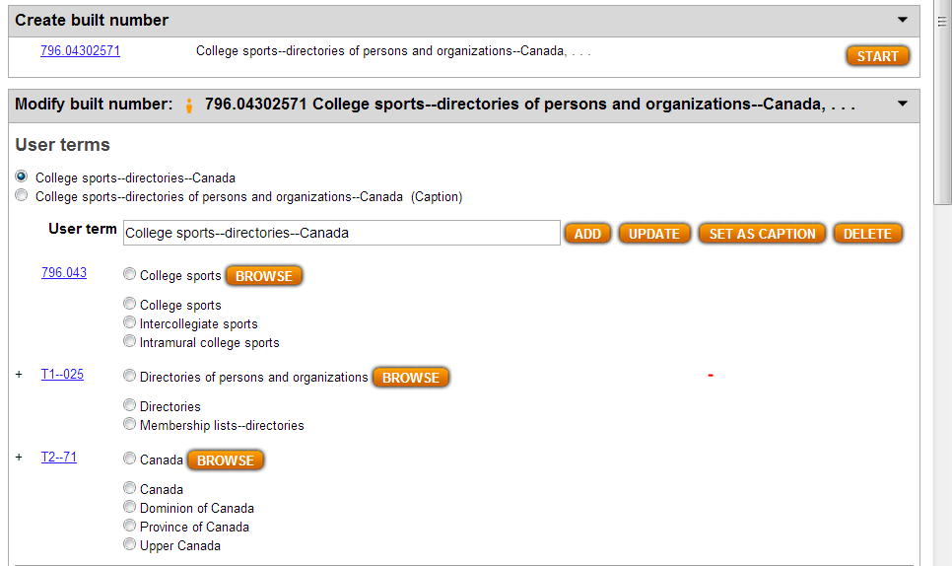
Select terms for caption
Add
Results from Add

Slide 34
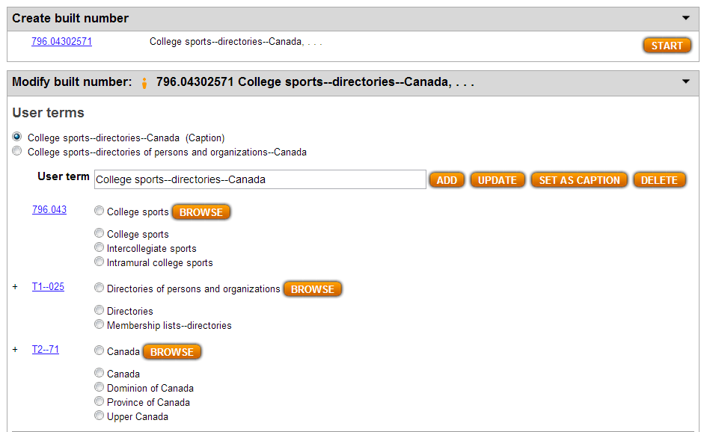
Use radio buttons to set as caption
Results

Slide 35
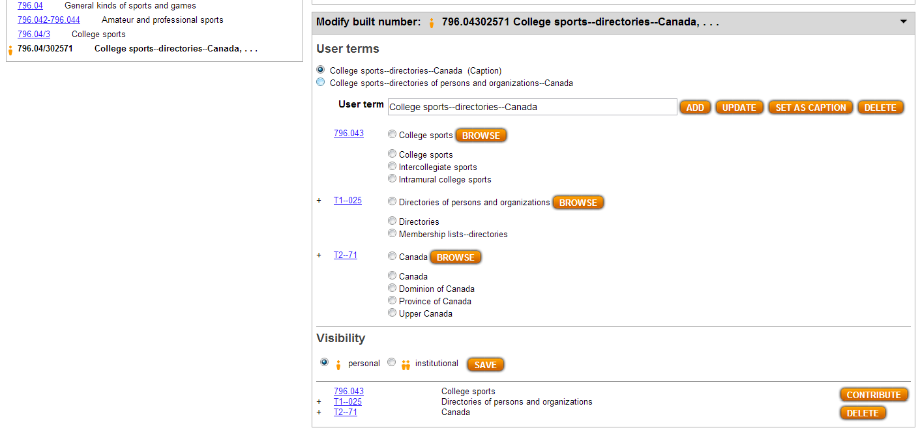
Save allows visibility as personal or institutional number
Contribute allows Dewey Editors to harvest

Slide 36







Symbols & meanings
Symbol | Meaning
 | Initiate number building process guided by Dewey instructions
 | Add components to number under construction
 | Delete last step in number building process
 | Edit number under construction
 | Cancel number building operation
 | Save number and initiate indexing
 | Edit and save term selected with the radio button
 | (near User term text box) Add and save term in User term text box
 | (in User terms area) Launch browse of Dewey number associated with component
 | (near User term text box) Remove the term selected with the radio button
 | Save number/caption with personal or institutional visibility as indicated by radio button
 | Send built number and user terms to Dewey editors
 | (below Contribute button) Delete built number and user terms from your WebDewey subscription

