Slide 1
WebDewey Number Building
Internal table examples
November 2016

Slide 2
Overall workflow
Find starting number/span with add instruction, else find base number
Click Start/Add
System displays notation specified by add instruction or displays Table 1 (in final step)
As needed, user navigates to next number/span with add instruction or base number
Number building complete?
No
Yes
Verify the number is correct, click Save
User term box appears, select user terms
Edit term, click Update
User term needs to be changed?
Yes
Additional term needed?
No
No
Yes
Create additional term, click Add
Select term to set as caption
Save as institutional or personal visibility
Verify presence in the hierarchy
Contribute to Dewey Editors (optional)
If not contributed to Dewey Editors, new number visible only to institution or person

Slide 3
Process of building 346.71086
Insurance law of Canada
Navigate to this number/span | Click | Number built so far | Caption of last number/notation added
346.3-346.9 | Start | 346 | Specific jurisdictions and areas
T2—71 | Add | 346.71 | Canada
346.3-346.9:01-09 | Add | 346.71 | Topics of private law
346.086 | Add | 346.71086 | Insurance

Slide 4
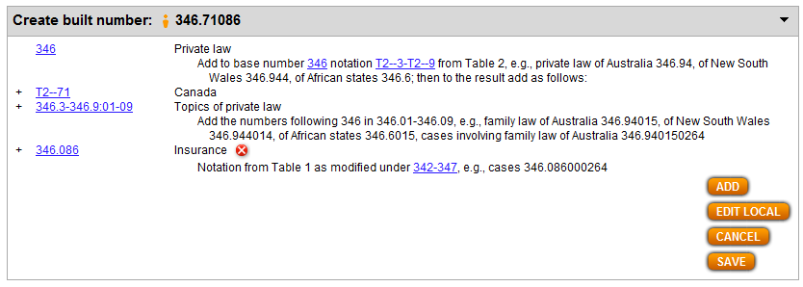
Results of process of building 346.71086 Insurance law of Canada

Slide 5
Process of building 363.19464
Inspection and testing of drugs and medicines
Navigate to this number/span | Click | Number built so far | Caption of last number/notation added
363.194 | Start | 363.194 | Drugs and medicines
362-363:64 | Add | 363.19464 | Inspection and testing

Slide 6
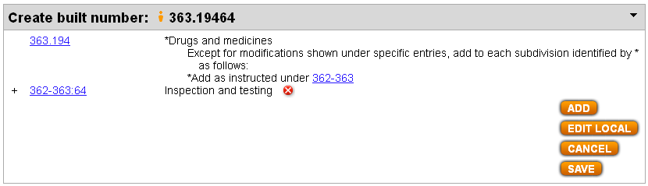
Results of process of building 363.19464 Inspection and testing of drugs and medicines

Slide 7
Process of building 616.833075
Parkinson disease—diagnosis
Navigate to this number/span | Click | Number built so far | Caption of last number/notation added
616.833 | Start | 616.833 | Parkinson disease and Lewy body dementia
616.1-616.9:075-079 | Add | 616.83307 | Diagnosis, prognosis, death, immunity
616.075 | Add | 616.833075 | Diagnosis and prognosis

Slide 8
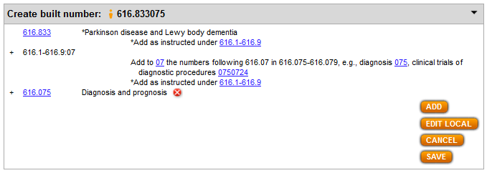
Results of process of building 616.833075 Parkinson disease—diagnosis

Slide 9
Process of building 785.7198
String octets
Navigate to this number/span | Click | Number built so far | Caption of last number/notation added
785.7 | Start | 785.7 | String ensembles
785.2-785.9:19 | Add | 785.719 | Size of ensemble
785.18 | Add | 785.7198 | Octets

Slide 10
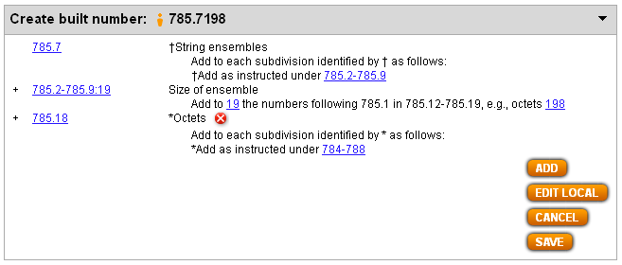
Results of process of building 785.7198
String octets

Slide 11
Process of building 949.8004924
History of Jews in Romania
Navigate to this number/span | Click | Number built so far | Caption of last number/notation added
930-990 | Start | 9 | History . . .
T2—498 | Add | 949.8 | Romania
930-990:0041-0049 | Add | 949.8004 | Specific ethnic and national groups
T5—924 | Add | 949.8004924 | Hebrews, Israelis, Jews

Slide 12
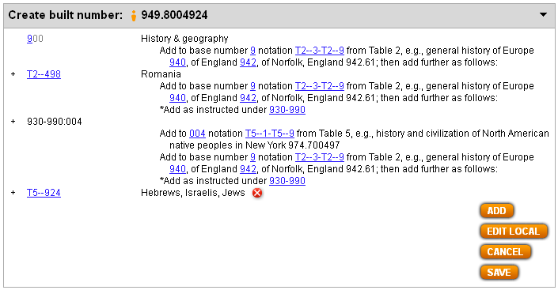
Results of process of building 949.8004924
History of Jews in Romania

Slide 13
Process of building 657.861009 (1)
History of accounting for labor unions
Navigate to this number/span | Click | Number built so far | Caption of last number/notation added
657.861 | Start | 657.861 | (Accounting for) Labor unions
657.8:001-009 | Add | 657.861 | Standard subdivisions
T1—09 | Add | 657.86109 | History . . .
 | Edit Local
 | . . .
Note: Add instruction at 657.861 (“add as instructed under 657.8”) and standard subdivisions entry in internal add table under 657.8 should lead to the building of 657.861009. Since the result here does not take into account that standard subdivisions are on two zeros, we need to click Edit Local to fix the number.

Slide 14
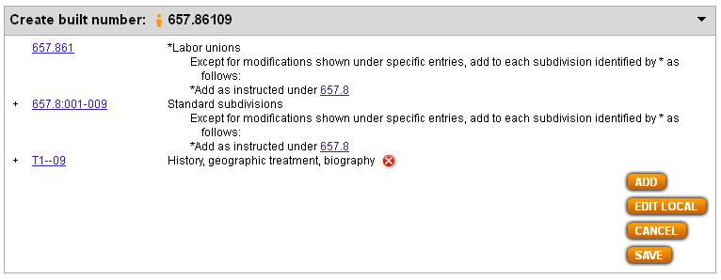
Process of building 657.861009 (2)
History of accounting for labor unions
Interim results (before clicking Edit Local):

Slide 15
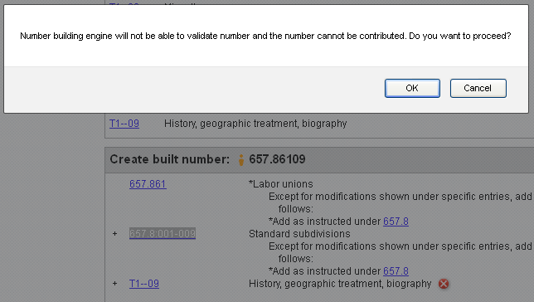
Process of building 657.861009 (3)
History of accounting for labor unions
After clicking Edit Local, user is alerted that proceeding with number building will result in a number that cannot be validated or contributed. If you wish to proceed, click OK.

Slide 16
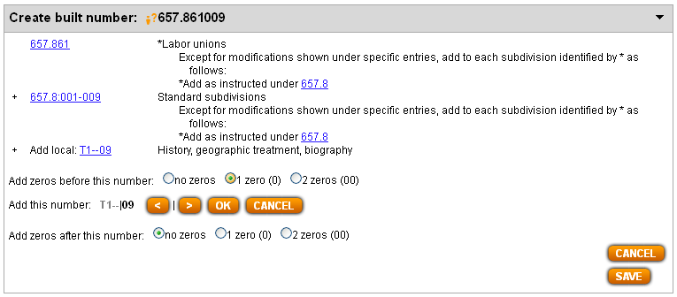
Process of building 657.861009 (4)
History of accounting for labor unions
User is presented with ability to add more zeros before and/or after Add local notation. We want 1 extra zero before the 09 portion of T1—09, so we click the 1-zero-(0) radio button in the “Add zeros before this number” line and then Click OK.

Slide 17
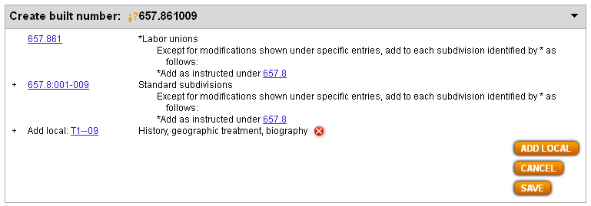
Results of process of building 657.861009 with Edit Local
History of accounting for labor unions
Note (1) ?-icon before built number and (2) “Add local:” before T1—09. Both elements indicate that the user had to go outside the regular number building routine to generate this number.

Slide 18
Additional examples in other modules
Module | Internal table notation
Standard subdivisions | T1—08:02
Religion | 221-229:01-08; 264.04-264.09:01-07; 274-279:01-08
Social sciences | 333.7-333.9:16
Law | 342-347:0261
Life sciences | 571.5-571.9:1-2; 583-588:1; 592-599:1
Medicine | 617:0083; 618.1-618.8:059
Music | 781.621-781.629:03-09; 782.1-782.4:11-17
Literature | T3B—102-T3B—107:08; 821-828:5
History and travel | 913-919:041-049

