Slide 1
WebDewey Number Building
Language examples
November 2012

Slide 2
Overall workflow
Find starting number/span with add instruction, else find base number
Click Start/Add
System displays notation specified by add instruction or displays Table 1 (in final step)
As needed, user navigates to next number/span with add instruction or base number
Number building complete?
No
Yes
Verify the number is correct, click Save
User term box appears, select user terms
Edit term, click Update
User term needs to be changed?
Yes
Additional term needed?
No
No
Yes
Create additional term, click Add
Select term to set as caption
Save as institutional or personal visibility
Verify presence in the hierarchy
Contribute to Dewey Editors (optional)
If not contributed to Dewey Editors, new number visible only to institution or person

Slide 3
Process of building 450.145
Pragmatics of Italian language
Navigate to this number/span | Click | Number built so far | Caption of last number/notation added
450 | Start | 45 | Italian . . .
T4—0145 | Add | 450.145 | Pragmatics

Slide 4
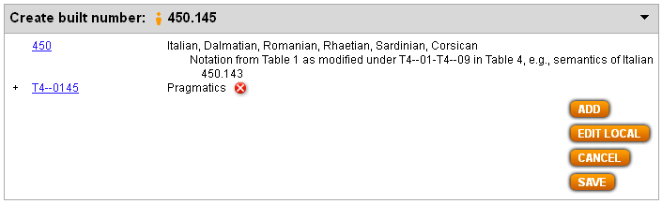
Results of process of building 450.145
Pragmatics of Italian language

Slide 5
Process of building 419.705
American Sign Language grammar
Navigate to this number/span | Click | Number built so far | Caption of last number/notation added
419.4-419.9 | Start | 419 | Sign languages . . .
T2—7 | Add | 419.7 | North America
T4—5 | Add | 419.705 | Grammar . . .

Slide 6
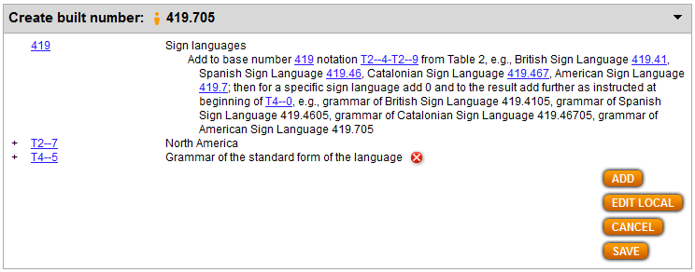
Results of process of building 419.705
American Sign Language grammar

Slide 7
Process of building 428.041061
Translating Spanish poetry into English
Navigate to this number/span | Click | Number built so far | Caption of last number/notation added
421-428 | Start | 42 | Subdivisions of English
T4—8041-T4—8048 | Add | 428.04 | Translating specific forms . . .
T3B—1 | Add | 428.041 | Poetry
T6—61 | Add | 428.041061 | Spanish

Slide 8
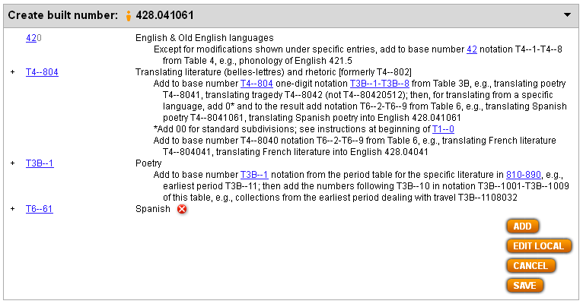
Results of process of building 428.041061
Translating Spanish poetry into English

Slide 9
Process of building 495.93286421
Khmer-language readers for English-speaking people
Navigate to this number/span | Click | Number built so far | Caption of last number/notation added
495.92-495.97 | Start | 495.9 | . . . Austroasiatic . . . languages
T6—95932 | Add | 495.932 | Khmer (Cambodian)
T4—8642-T4—8649 | Add | 495.932864 | Readers for speakers of . . .
T6—21 | Add | 495.93286421 | English

Slide 10
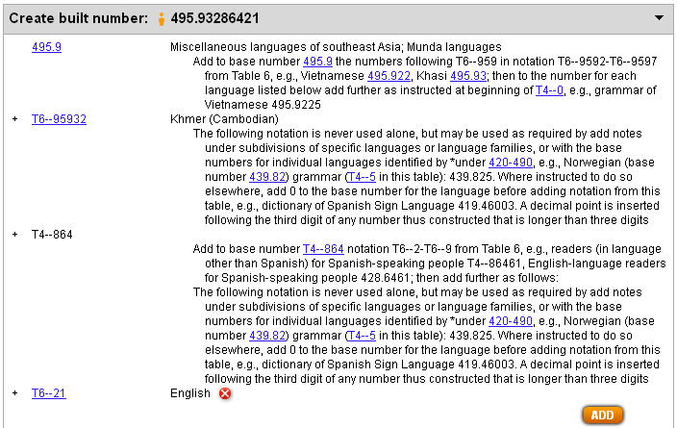
Result of building 495.93286421
Khmer-language readers for English-speaking people

