Slide 1
WebDewey Number Building
Life science examples
November 2016

Slide 2
Overall workflow
Find starting number/span with add instruction, else find base number
Click Start/Add
System displays notation specified by add instruction or displays Table 1 (in final step)
As needed, user navigates to next number/span with add instruction or base number
Number building complete?
No
Yes
Verify the number is correct, click Save
User term box appears, select user terms
Edit term, click Update
User term needs to be changed?
Yes
Additional term needed?
No
No
Yes
Create additional term, click Add
Select term to set as caption
Save as institutional or personal visibility
Verify presence in the hierarchy
Contribute to Dewey Editors (optional)
If not contributed to Dewey Editors, new number visible only to institution or person

Slide 3
Process of building 584.72168
Rare and endangered orchids
Navigate to this number/span | Click | Number built so far | Caption of last number/notation added
584.72 | Start | 584.72 | Orchidaceae
583-588:1 | Add | 584.91 | General topics of natural history of plants
581.68 | Add | 584.4168 | Rare and endangered plants

Slide 4
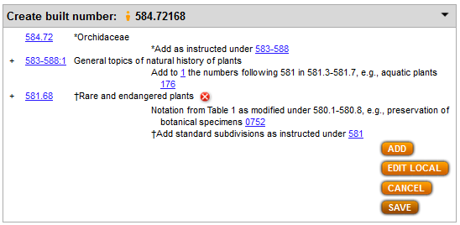
Results of process of building 584.72168
Rare and endangered orchids

Slide 5
Process of building 597.96156
Reproductive behavior of snakes
Navigate to this number/span | Click | Number built so far | Caption of last number/notation added
597.96 | Start | 597.96 | Serpentes (Snakes)
592-599:1 | Add | 597.961 | General topics of natural history of animals
591.56 | Add | 597.96156 | Behavior relating to life cycle

Slide 6
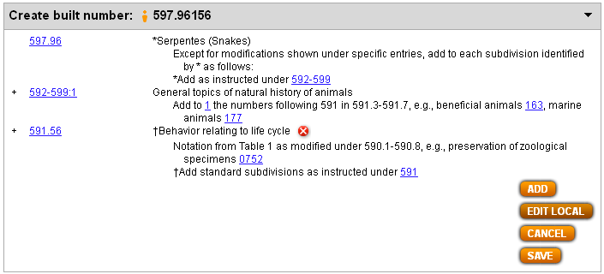
Results of process of building 597.96156
Reproductive behavior of snakes

Slide 7
Process of building 571.99917
Parasitic diseases in fish
Navigate to this number/span | Click | Number built so far | Caption of last number/notation added
571.999 | Start | 571.999 | Parasitic diseases
571.5-571.9:1-2 | Add | 571.999 | Specific kinds of organisms
571.11-571.19 | Add | 571.9991 | Specific kinds of animals
597 | Add | 571.99917 | Cold-blooded vertebrates

Slide 8
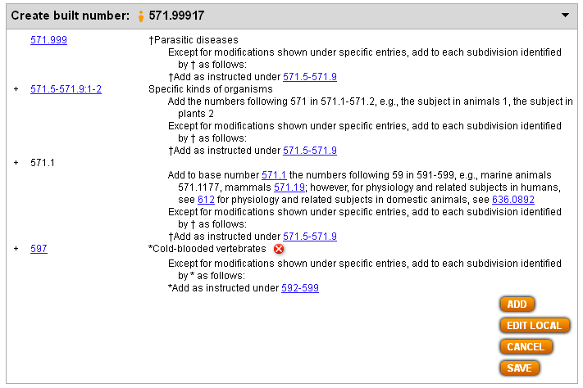
Result of building 571.99917
Parasitic diseases in fish

