Slide 1
WebDewey Number Building
Standard subdivision examples
November 2012

Slide 2
Overall workflow
Find starting number/span with add instruction, else find base number
Click Start/Add
System displays notation specified by add instruction or displays Table 1 (in final step)
As needed, user navigates to next number/span with add instruction or base number
Number building complete?
No
Yes
Verify the number is correct, click Save
User term box appears, select user terms
Edit term, click Update
User term needs to be changed?
Yes
Additional term needed?
No
No
Yes
Create additional term, click Add
Select term to set as caption
Save as institutional or personal visibility
Verify presence in the hierarchy
Contribute to Dewey Editors (optional)
If not contributed to Dewey Editors, new number visible only to institution or person

Slide 3
Process of building 662.2705
Journal of high explosives
Navigate to this number/span | Click | Number built so far | Caption of last number/notation added
662.27 | Start | 662.27 | High explosives
T1—05 | Add | 662.2705 | Serial publications

Slide 4
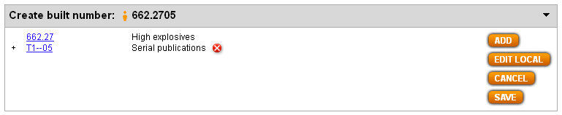
Results of process of building 662.2705
Journal of high explosives

Slide 5
Process of building 797.2340972921
Scuba diving in the Cayman Islands
Navigate to this number/span | Click | Number built so far | Caption of last number/notation added
797.234 | Start | 797.234 | Scuba diving
T1—093-099 | Add | 797.23409 | Specific . . . localities . . .
T2—72921 | Add | 797.2340972921 | Cayman Islands

Slide 6
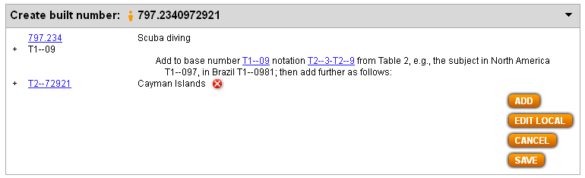
Results of process of building 797.2340972921
Scuba diving in the Cayman Islands

Slide 7
Process of building 808.5102432422
Public speaking for politicians
Navigate to this number/span | Click | Number built so far | Caption of last number/notation added
808.51 | Start | 808.51 | Public speaking (Oratory)
T1—024 | Add | 808.51024 | The subject for people in . . .
324.22 | Add | 808.5102432422 | Leadership (“Class here politics as a profession, occupation, hobby”)

Slide 8
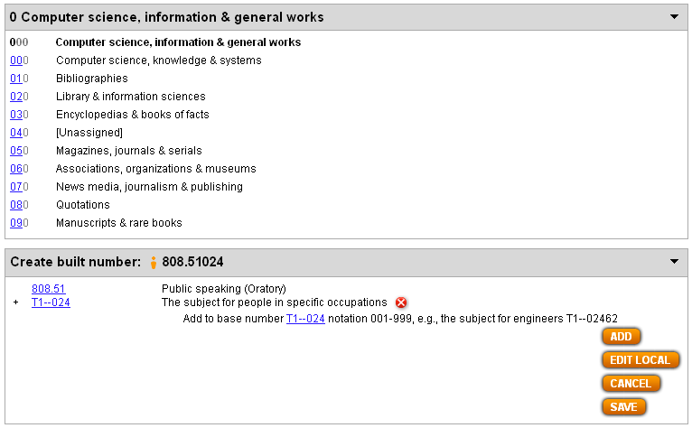
Instruction to “add . . . notation 001-999” leads to main class 0; if required, search for desired notation to add (in this case, 324.22)

Slide 9
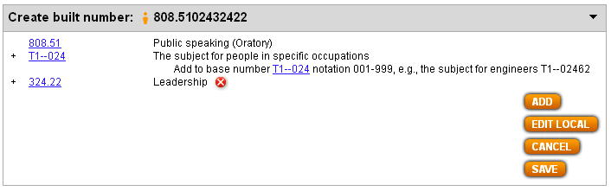
Results of process of building 808.5102432422
Public speaking for politicians

Slide 10
Process of building 332.75086202
Bankruptcy statistics by socioeconomic levels
Navigate to this number/span | Click | Number built so far | Caption of last number/notation added
332.75 | Start | 332.75 | Insolvency
T1—0862 | Add | 332.750862 | People by social and economic levels
T1—08:02 | Add | 332.75086202 | Statistics . . .

Slide 11
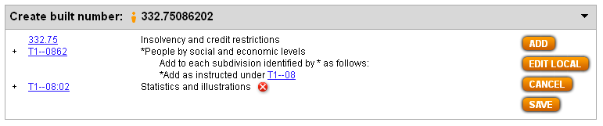
Results of process of building 332.75086202
Bankruptcy statistics by socioeconomic levels

Slide 12
Process of building 153.940003
Encyclopedia of aptitude testing
Navigate to this number/span | Click | Number built so far | Caption of last number/notation added
153.94 | Start | 153.94 | Aptitude tests
T1—03 | Add | 153.940003 | Dictionaries, encyclopedias, concordances
Note: As seen in this example, the number building engine responds to the presence of schedule numbers indicating that standard subdivisions are on more than 1 zero (in this case, 153.940001-153.940009 Standard subdivisions).

Slide 13
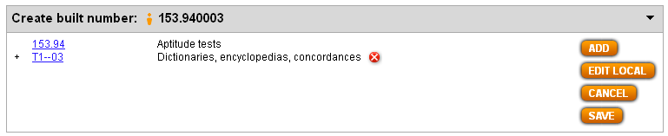
Results of process of building 153.940003
Encyclopedia of aptitude testing
Note: The number building engine does not yet respond to the presence of internal add table notation indicating that standard subdivisions are on more than 1 zero, as will be seen in the next example.

Slide 14
Process of building 657.861009 (1)
History of accounting for labor unions
Navigate to this number/span | Click | Number built so far | Caption of last number/notation added
657.861 | Start | 657.861 | (Accounting for) Labor unions
657.8:001-009 | Add | 657.861 | Standard subdivisions
T1—09 | Add | 657.86109 | History, . . .
 | Edit Local
 | . . .
Note: Add instruction at 657.861 (“add as instructed under 657.8”) and standard subdivisions entry in internal add table under 657.8 should lead to the building of 657.861009. Since the result here does not take into account that standard subdivisions are on two zeros, we need to click Edit Local to fix the number.

Slide 15
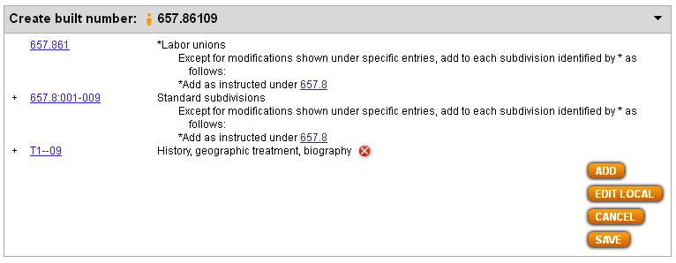
Process of building 657.861009 (2)
History of accounting for labor unions
Interim results (before clicking Edit Local):

Slide 16
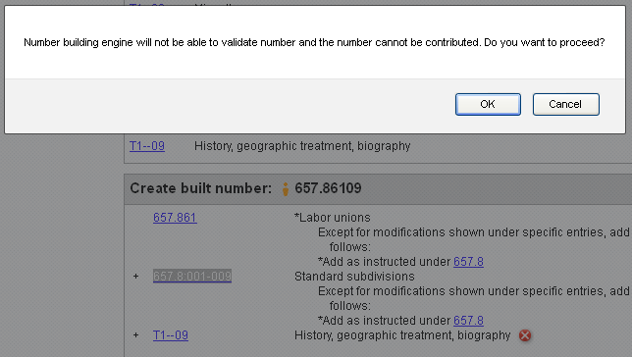
Process of building 657.861009 (3)
History of accounting for labor unions
After clicking Edit Local, user is alerted that proceeding with number building will result in a number that cannot be validated or contributed. If you wish to proceed, click OK.

Slide 17
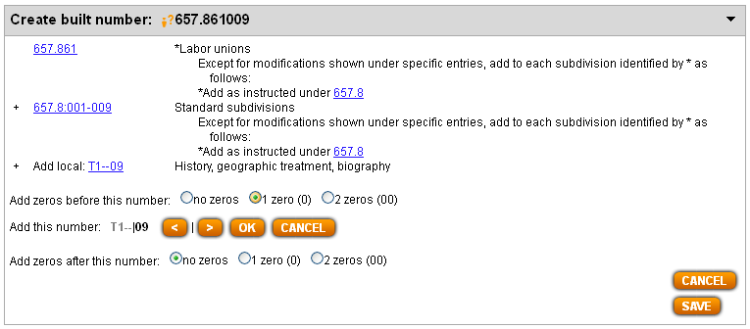
Process of building 657.861009 (4)
History of accounting for labor unions
User is presented with ability to add more zeros before and/or after Add local notation. We want 1 extra zero before the 09 portion of T1—09, so we click the 1-zero-(0) radio button in the “Add zeros before this number” line and then Click OK.

Slide 18
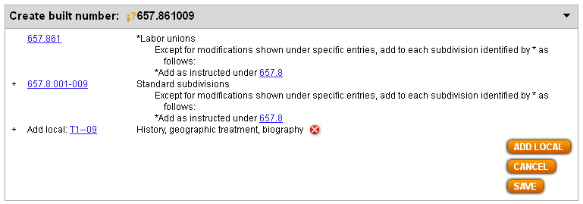
Results of process of building 657.861009 with Edit Local
History of accounting for labor unions
Note (1) ?-icon before built number and (2) “Add local:” before T1—09. Both elements indicate that the user had to go outside the regular number building routine to generate this number.

