Slide 1
IATUL SEMINAR 2019 – Gdańsk, Poland
The effects of the shift to open on research libraries
Titia van der Werf
OCLC Research, Europe

Slide 2

Titia van der Werf
OCLC Research Europe
Notes:
I am program officer at OCLC Research, in Leiden the Netherlands.

Slide 3
The open content survey
Notes:
I will give a short overview of the survey purpose and methodology and then I will share some of the findings as they relate to Research Libraries.

Slide 4
Purpose
To engage a global audience of librarians in a joint exercise, asking them to:
Map and align their open content efforts and activities
Explore current levels of funding and staffing in open content activities
Identify areas of cooperation with OCLC to leverage their open content efforts
Notes:
Defining the purpose and the scope of the topic was a crucial exercise. Our aim was to engage librarians in a joint exercise to map and assess their open content efforts and to explore their current investment in this type of content. We also hoped to identify areas where librarians could work together with OCLC to leverage their efforts and to widen access to free, online content.

Slide 5
Scope
Not only OA – also other freely available online open content
Acknowledging the continuum of openness
Global survey
All library types
Notes:
The scope was intentionally broad. Not just OA publications, also all other types of open content: pre-prints and green-OA, digitized open collections from heritage institutions, open government data and research data, software and tools, gray literature, Open Educational Resources, etc. We wanted to hear the voices of all library types across the world and capture the diversity of their perspectives. We wanted to bring together the voices from across the content-silos and workflow silos of the institutional repositories, e-resources management, Digital Libraries, Data Services, etc. The survey was promoted as widely as possible through the networks of the Global Council delegates, the RLP and relevant mailing-lists from LIBER, COAR, GreyNet, etc.

Slide 6
Open Content activity categories (1)
1 Advocacy and policies
2 Publishing
3 Digitizing collections
4 Data services
5 Supporting authors, researchers, teachers in creating open content
6 Bibliometrics
7 Supporting users, instructing, digital literacy programs
8 Selecting open content NOT managed by the library
9 Promoting the discoverability
10 Deep interactions with open content
Notes:
In order to be able to map and align Open Content activities and efforts, we identified a set of 14 activity categories from which the survey respondents could chose. The first 6 categories relate to “Producing Open Content”:
1 Advocacy and policies promoting open content = awareness-raising, legislation, mandates, regulations, policies, standardization, staff training.
2 Publishing open content = library as a publisher of open content.
3 Digitizing collections = digitize and make collections available online as open collections; rights clearance.
4 Data services = publishing open datasets (government data; research data; etc.)
5 Supporting authors/researchers/teachers in creating open content = provide guidance and training; help with OA-funding and/or negotiating discounts.
6 Bibliometrics = collect metrics to help measure OA-impact;
The following 4 categories relate to “Making Open Content discoverable and reusable”:
7 Supporting users/instructing/digital literacy programs = provide instruction and help with the selection, evaluation and use of open content; etc.
8 Selecting open content not managed by the library = select and validate open content to include in libguides, catalogues and discovery tools. E-resource management for OA; checking license terms of use; link to archive or last-resort copy; etc.
9 Promoting the discovery of open content = make open content easy to find and use; enable OA-buttons and copy-request buttons in discovery and ILL-workflows; etc.
10 Deep interactions with open content = platforms/labs to interact with open collections or open datasets; NLP tools for close-reading; etc.

Slide 7
Open Content activity categories (2)
11 Institutional repository
12 Digital collections library
13 Born-digital (legal) deposit / web-archive
14 Assessment
Notes:
… the categories 11-13 relate to maintaining operational repository and archiving systems of open content and making disseminating that content:
11 Institutional repository = maintain an archive for depositing, preserving and disseminating the intellectual output of your parent institution – grey literature, “green-OA”, open research datasets, open software tools, etc. – and making these outputs discoverable and re-usable as open content.
12 Digital collections library = maintain a digital library for storing, preserving and disseminating your library’s digitized collections and making these collections discoverable and re-usable as open content.
13 Born-digital (legal) deposit / web-archive = maintain an archive for preserving and long-term access to born-digital open content, including scientific OA-publications, as part of your library’s collection tasks and responsibilities.
The last category is Assessment, which relates to all the previous 13 activity categories and measuring use and successfulness of these services:
14 Assessment = measure usage of open content in your library’s (dissemination and discovery) services; gather user feedback.

Slide 8
Concerning these 14 activity categories, we asked…
Where are you involved?
Is there identified funding for these activities?
Where are you successful?
Where do you want to accelerate the impact?
What is the right scale for achieving (institutional, regional, national, global)?
Where do you see a role for OCLC?
Notes:
Concerning these 14 activity categories, we asked:
Where are you invested?
Is there identified funding for the activities?
Where are you successful?
Where do you want to accelerate impact of services?
What is the right scale (institutional, regional, national, global)?
Where do you see a role for OCLC?
Where is the work of OCLC Research likely to help you make more impact?
We hoped that these questions would trigger the respondents to think about Open Content as being a part of their “normal” workflows and what it entails to make that part more explicit. And this inevitably raised awareness and questions about the need to separate out the open content part of workflows and what it entails to make that part more explicit. Most respondents had difficulty quantifying their library's investments and expenditures spent on open content activities. Yet, many gave it a serious try and could indicate - for each activity - the funding sources that are designated by their library’s planning and budgeting. We hoped that they would find this a useful exercise. And they did!

Slide 9
Has trying to make your investment in open content activities more explicit, been a useful exercise to you?
Why or why not?
Notes:
We asked: “Has trying to make your investment in open content activities more explicit, been a useful exercise to you? Why or why not?” and twice as many respondents found it a useful exercise as those who did not.

Slide 10
It has brought home that this is not something we're able to quantify at the moment (UL, UK)
No, it is too entangled with other support activities to make it more explicit. Though it is useful to take into account maintaining a RIS and institutional repository has become a substantial activity over the last 10 years (about 15% of budget) (UL, Netherlands)
Notes:
Those who did not find it a useful exercise said they haven’t tried or are just beginning with their efforts to make Open Content investments more explicit (22%) and they also found they were unable to make investments more explicit because Open Content is incorporated in existing services and is thought of as normal workflow activity (16%).

Slide 11
Yes. This survey gives us a nice opportunity to think about our open access policy, to brainstorm about our open content activities (measuring success and identifying areas for improvement). This was a very interesting exercise. Thank you for that. (UL, France)
Yes, it has helped to highlight where some of this activity is taking place, and that it is embedded in more areas of Library Services than we were aware of; open content is treated the same way as paid for content in many respects (for example when switching on for discovery services, or including in information literacy teaching), but this still counts as investment in open content activities. (UL, UK)
Notes:
Those who felt making investment in open content activities more explicit had been a useful exercise, said it increases the awareness/promotion/support (21%) and visibility/usage (meets users’ needs) (18%) related to open content.

Slide 12
Useful to see we are well on the way to 2.5% contribution level! (UL, US)
Notes:
Finally, one University Librarian from the US said it had been useful to see they were well on the way to 2.5% contribution level – referring to the “2.5% commitment” discussion in the USA and the call for action to every academic library to dedicate 2.5% of its budget to supporting a common infrastructure for open scholarly communications.

Slide 13
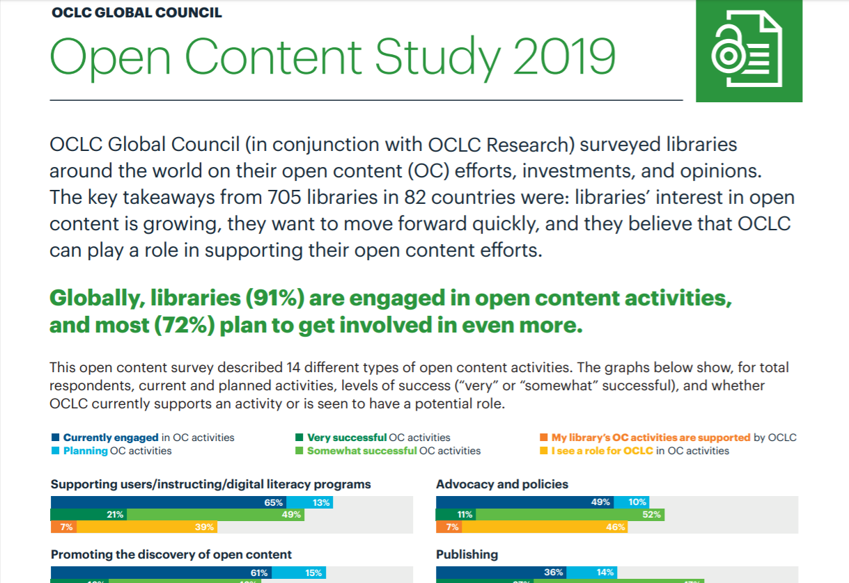
SURVEY FINDINGS PUBLISHED
oc.lc/oa
Notes:
The results of the survey have been summarized in a 2-pages leaflet that you can find online at: https://www.oclc.org/content/dam/oclc/services/brochures/216262-WWAE_Open-Content-survey-results.pdf
The main takeaway is that globally, libraries are already invested in Open Content and their interest in Open Content is growing. They want to move forward quickly – and in Asia Pacific and Europe more so than in other regions. They also believe that OCLC can play a role in supporting their Open Content efforts.

Slide 14
University & Research Libraries
Notes:
Let’s take a deep dive now and look at the data from the University & Research Libraries.

Slide 15
Total Responses by Library Type
Research & University:
511 responses from 69 countries
n = 705
Notes:
As you can see, nearly ¾ (72%) of the respondents are University & Research Libraries. This group is clearly the majority segment of our sample. Therefore it makes sense to just focus on the responses from this group. With 511 respondents from 69 countries – this group provides an insightful and current snapshot of the state of open content support in higher education and research.

Slide 16
University & Research Libraries Responses by Region
Countries by region, with number of respondents >14
Americas (236) |  | EMEA (201) |  | Asia Pacific (74)
United States | 204 | UK | 33 | Australia | 19
Canada | 21 | Germany | 19 | Philippines | 16
 |  | Turkey | 17
 |  | France | 15
 |  | Netherlands | 15
Notes:
But, as you can see on this slide, not all regions are equally well represented and - within the regions - not all countries are equally well represented.
In the table you can see the countries by region where the number of respondents is larger than 14.
So, the Research Library respondents from the Americas come overwhelmingly from the States; 2/3 of respondents from the EMEA region come from European countries; nearly half of the respondents from Asia Pacific come from Australia and the Philippines.
We should also understand that a given number of respondents is not necessarily equally representative across countries. So, for example, 15 respondents from the Netherlands is quite representative as there are only so many universities in the Netherlands – whilst 15 respondents from France is much less representative for a country with over 500 research libraries.
I will share the findings relating to the University & Research Libraries as a group, but please be aware that there are significant differences by country. We have no time today to look at the data at the country level, but these will be presented in subsequent publications and presentations.

Slide 17
Interpretive framework
Notes:
Looking at the data and the charts across all 14 service categories can be quite overwhelming and difficult to interpret. What is the data telling us? I have decided to group the open content activity categories in a way that might inform our thinking at OCLC Research about “the collection directions”. This presentation is a work-in progress regarding the development of the interpretive framework and the interpretation of the survey data.

Slide 18
Collection directions
The collective collection
Reconfiguration
of library collaboration
by network/digital environment.
The inside out collection
Reconfiguration
of research work
by network/digital environment.
The facilitated collection
Reconfiguration
of the information space
by network/digital environment.
Notes:
Lorcan Dempsey has presented and published about the three collection directions in the past years and I propose to use his typology as a framework to interpret the survey data.
The three collection types are: 1) the Collective Collection, 2) the Inside-out Collection and 3) the Facilitated Collection.
All three have emerged through reconfigurations by the network/digital environment in which libraries operate – and they are being impacted by the Shift to Open, a trend I will talk shortly about at the end of my presentation.

Slide 19
Licensed Collection

Slide 20
Local
Scholarly record
Licensed Collection
Publishing
Supporting authors
Research Data Management
Institutional Repositories
Web-archiving
Bibliometrics

Slide 21
Local
Print/Special Collections
Local
Scholarly record
Licensed Collection
Digitization
Digital Collections Library
Deep interactions with open content
Publishing
Supporting authors
Research Data Management
Institutional Repositories
Web-archiving
Bibliometrics

Slide 22
Local
Print/Special Collections
Local
Scholarly record
Licensed Collection
Inside-out Collection
Advocacy and policies
Digitization
Digital Collections Library
Deep interactions with open content
Publishing
Supporting authors
Research Data Management
Institutional Repositories
Web-archiving
Bibliometrics

Slide 23
OPEN WEB
OPEN ACCESS Scholarly Record
CLOSED
Scholarly Record
Local
Print/Special Collections
Local
Scholarly record
Licensed Collection
Inside-out Collection
Advocacy and policies
Digitization
Digital Collections Library
Deep interactions with open content
Publishing
Supporting authors
Research Data Management
Institutional Repositories
Web-archiving
Bibliometrics

Slide 24
OPEN WEB
Open Digitized Collections
OPEN ACCESS Scholarly Record
CLOSED
Scholarly Record
Shared Collections
Borrowed Collection
Local
Print/Special Collections
Local
Scholarly record
Licensed Collection
Inside-out Collection
Advocacy and policies
Digitization
Digital Collections Library
Deep interactions with open content
Publishing
Supporting authors
Research Data Management
Institutional Repositories
Web-archiving
Bibliometrics

Slide 25
Supporting users
Promoting discoverability
Selecting content NOT managed by my library
Facilitated Collection
OPEN WEB
Open Digitized Collections
OPEN ACCESS Scholarly Record
CLOSED
Scholarly Record
Shared Collections
Borrowed Collection
Local
Print/Special Collections
Local
Scholarly record
Licensed Collection
Inside-out Collection
Advocacy and policies
Digitization
Digital Collections Library
Deep interactions with open content
Publishing
Supporting authors
Research Data Management
Institutional Repositories
Web-archiving
Bibliometrics

Slide 26
Current open content activities
FACILITATED

Slide 27
Very successful open content activities
FACILITATED
INSIDE-OUT

Slide 28
No source of investment/not sure
FACILITATED
INSIDE-OUT

Slide 29
Want to accelerate impact
FACILITATED
INSIDE-OUT

Slide 30
Planned open content activities
FACILITATED

Slide 31
Findings
Relating to:
  the inside-out collection
libraries are currently not equally involved in all open content activities, but they plan to be involved in more. They are overall more invested, more successful and more confident to achieve impact in this area …

Slide 32
Findings
Relating to:
  the inside-out collection
libraries are currently not equally involved in all open content activities, but they plan to be involved in more. They are overall more invested, more successful and more confident to achieve impact in this area …
then in:
the facilitated collection
… where >50% of them are currently involved - yet, they indicate significant gaps in funding and success.
Notes:
There is a gap here that seems to suggest that facilitating access to Open Content NOT managed by the library is less prioritized, less-top-of-mind to University & Research Libraries, as a group.

Slide 33
“just because something is OPEN doesn’t mean it’s accessible”
Notes:
The Facilitated access model seems to be under pressure, and this raises some concerns – because, as we all know: Just because something is Open Access doesn’t mean it is accessible. Think of all the different OA- and free versions of papers available on the Web, and the difficulties for users to chose from and to understand the differences. Think of the pay-walled infrastructures and services, those requiring authorization and blocking 1-click access to Open Content. All examples of serious barriers to open access. We are seeing researchers and students increasingly turning to alternative sources, shadow libraries – like SciHub -, where access is more convenient and effective.

Slide 34


G.emmerich
https://creativecommons.org/licenses/by-sa/3.0/legalcode
(https://commons.wikimedia.org/wiki/File:Open_Science_Logo_v2.jpg), „Open Science Logo v2“
(https://commons.wikimedia.org/wiki/File:Open_Science_Logo.jpg), „Open Science Logo“
Notes:
If the “inside-out” collection and activities “making content open” receive more priority/attention from Research Libraries this fits perfectly in the Open Science trend which promotes opening-up and speeding up the reuse of scientific data through policies at all levels: institutional, national, regional, international.
In its broadest sense, open science is about the transition to open research practices, open scholarly communications and open participation in research. Essentially, it is about reforming scientific practice and breaking down IP-barriers. Like with OGD, it is about creating access to data/content that would otherwise be closed, and in doing so, dramatically lowering reuse costs. In this context, we are also witnessing a significant shift within library land, from pay-to-read to pay-to-publish content and the release of significant amounts of research datasets.

Slide 35
The shift to open: a trend
Open policies emphasize openness and reusability.
They are driving libraries to invest more in the inside-out collection:
  Digitizing print collections and clearing rights for re-use
  Supporting Open Access publishing
  Supporting Open Data reuse
Notes:
The Shift to Open trend is driven by open policies (in government and in science) and these in turn are driving libraries to shift and refocus their strategic directions and activities. The survey data shows that this is more so the case in countries where policy implementations are more developed – typically in the UK, Australia and the Netherlands.
This trend leads to the availability of much larger quantities of content being available as open content on the web. This necessarily affects library collections and services. So exploring the characteristics of the Shift to Open trend will help us understand better libraries choices and investment in Open Content.

Slide 36
Publication in progress
Report on Open Content support by Research Libraries (March 2020)
Dataset will be open and available at:
  oc.lc/research
Follow our blog at Hangingtogether.org
Notes:
Here is the timeline for the planned publications on this topic:
A Report on Open Content Support by Research Libraries – based on the survey findings – (beginning next year)
The dataset of the survey results.
Please follow the Hangingtogether.org blog of OCLC Research to learn more about the work we do on this topic.

Slide 37
Thank you!

