Slide 1
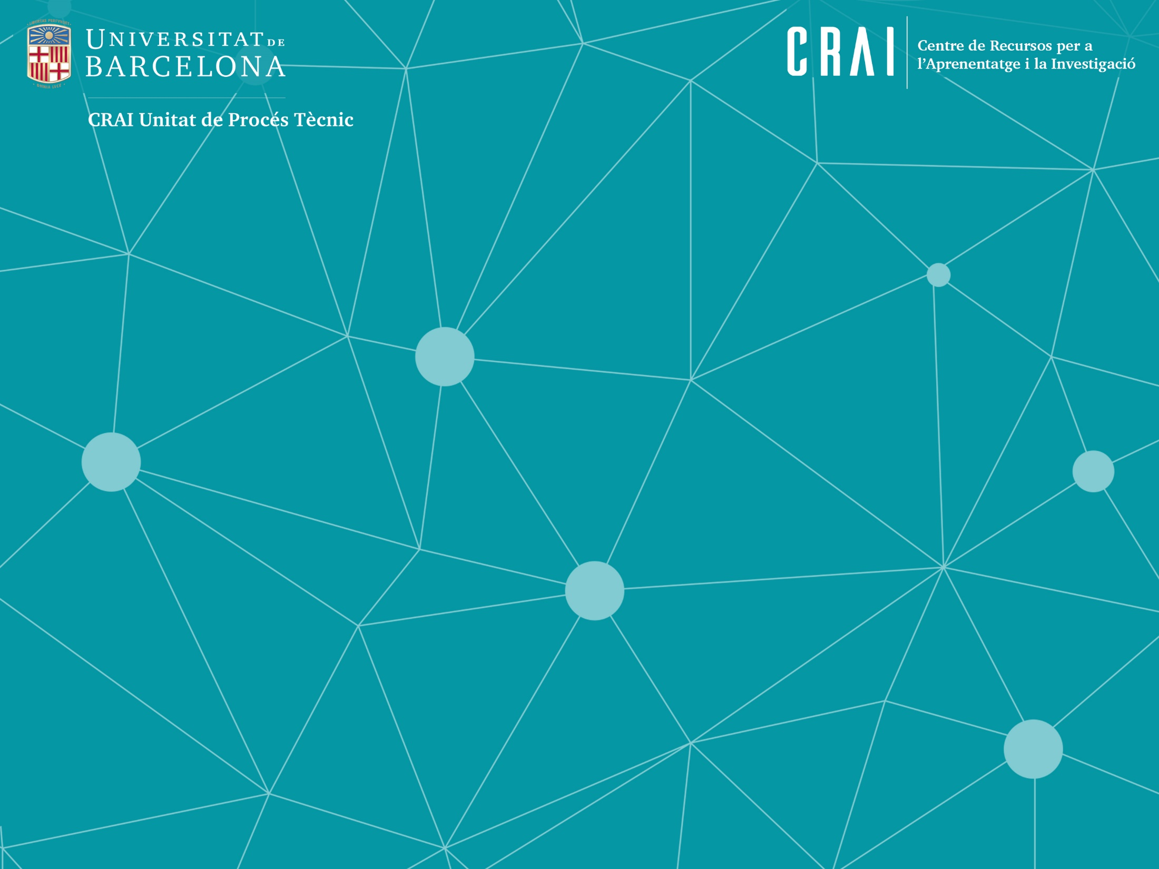

Professors UB :
bases for a Linked Open Data project
Rosa Fabeiro i Anna Rovira

Slide 2
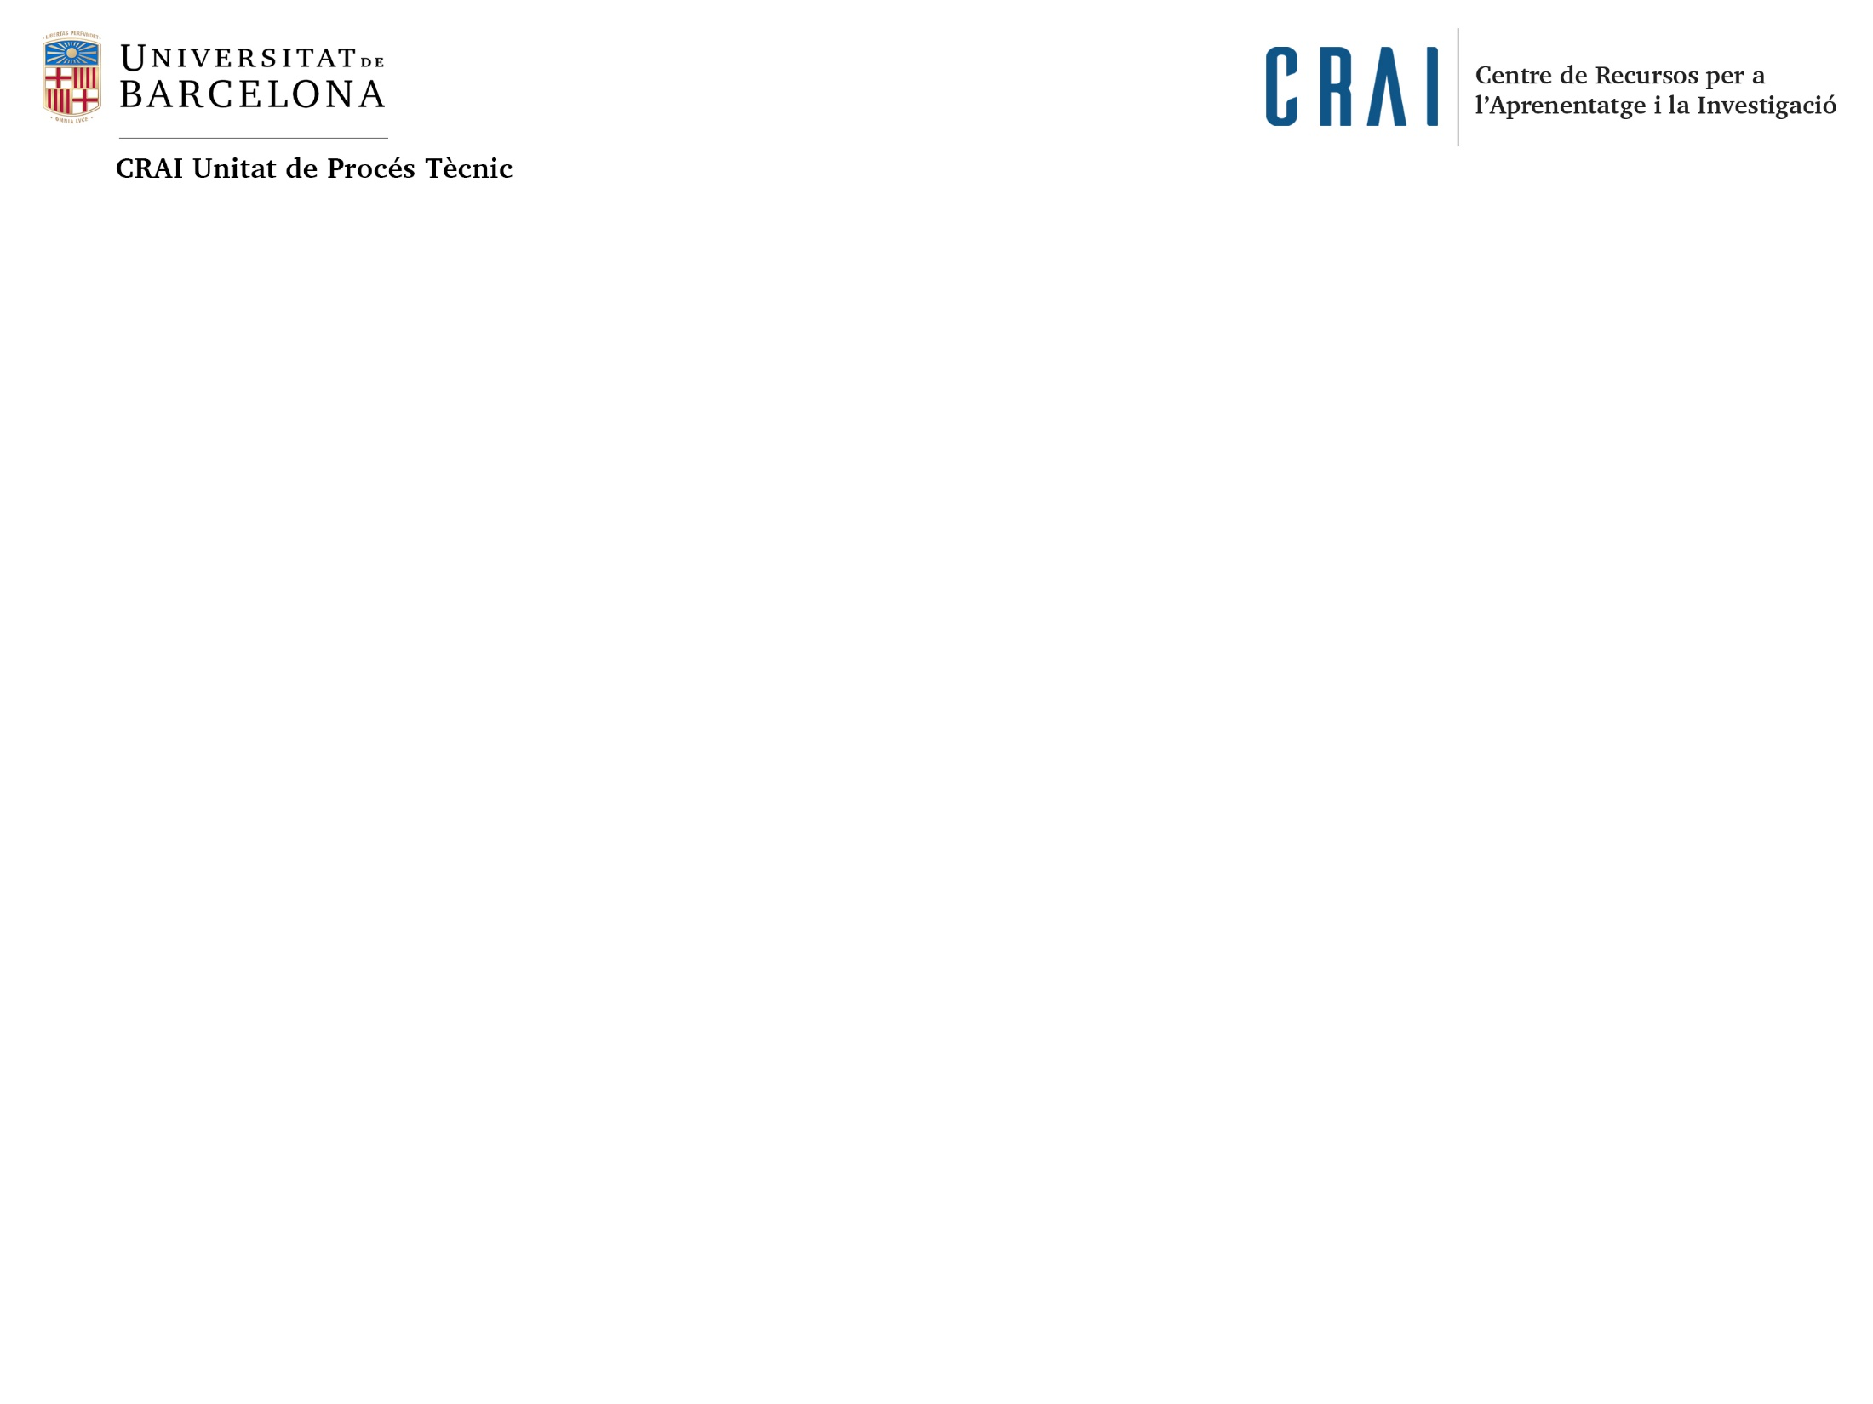
We have ... A need to interconnect our authorities
and do it easily, open, and scalable
Professors UB
Authorities set
Discovery
Analogic & electronic publications
Digital repository
Research publications
GREC
UB CRIS
External silos of information
Dialnet, google scholar, etc.
Professors UB : bases for a Linked Open Data project. Rosa Fabeiro I Anna Rovira
Authorities and Identifiers: How Do We Move Forward? An OCLC Research Symposium. Barcelona. 03/12/2019

Slide 3
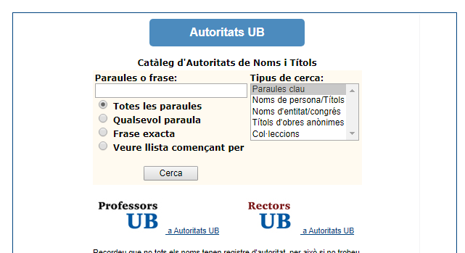
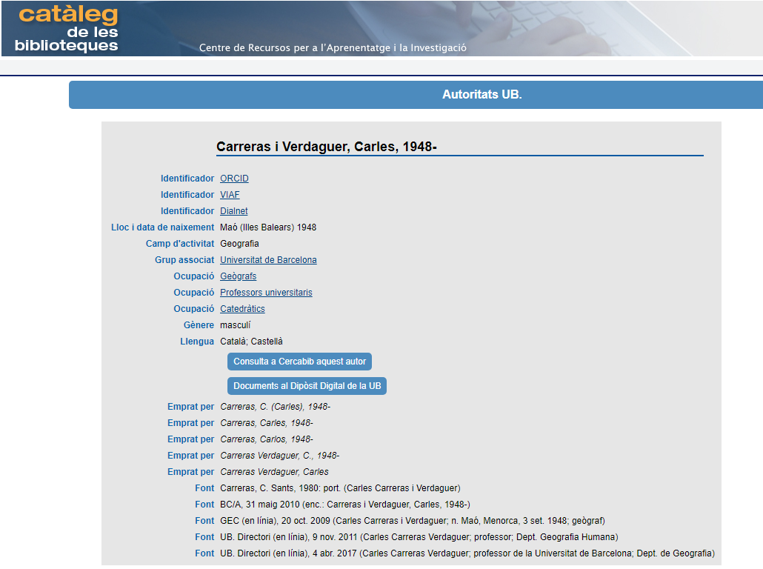
We have done ... A lot of work to connect
In the Authorities file
Define the set of authorities
Improve metadades with new RDA fields
Include identifiers extracted from the CRIS (ORCID, Scopus, Researcher ID, VIAF, Dialnet)
Include alternative name forms extracted from the CRIS
Identify and disambiguate our entities
In the CRIS and the Repository
Ask researchers to include their ORCID in CRIS
Include and update weekly our authorities in the process of reviewing publications before entering them into the repository
Identify new activity in researchers and complete the authorities
Review the CRIS to identify new identifiers
Professors UB : bases for a Linked Open Data project. Rosa Fabeiro I Anna Rovira
Authorities and Identifiers: How Do We Move Forward? An OCLC Research Symposium. Barcelona. 03/12/2019

Slide 4
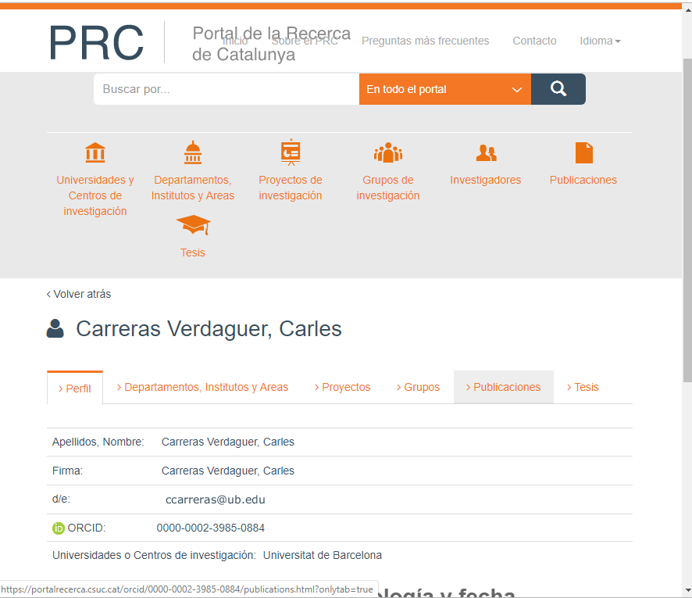
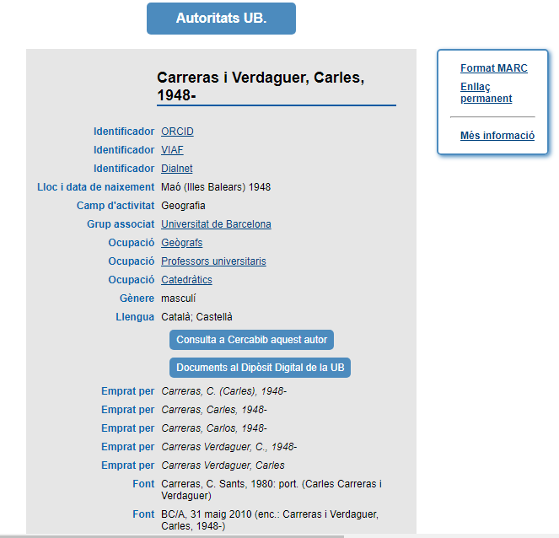
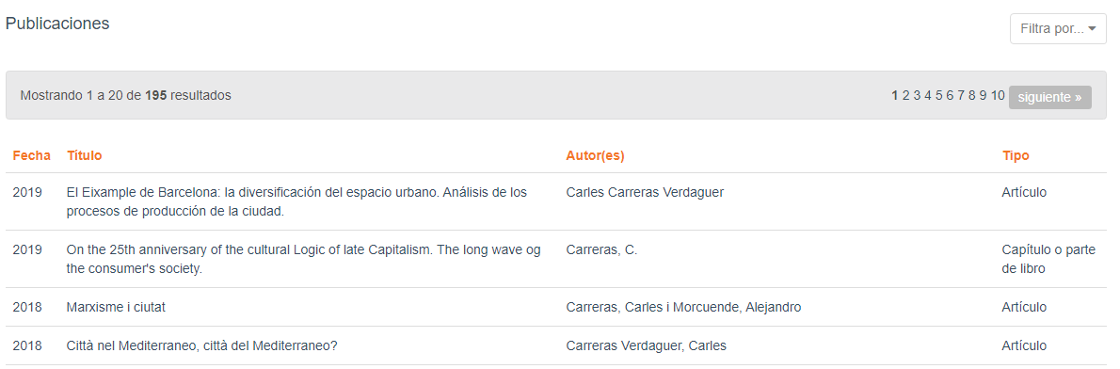
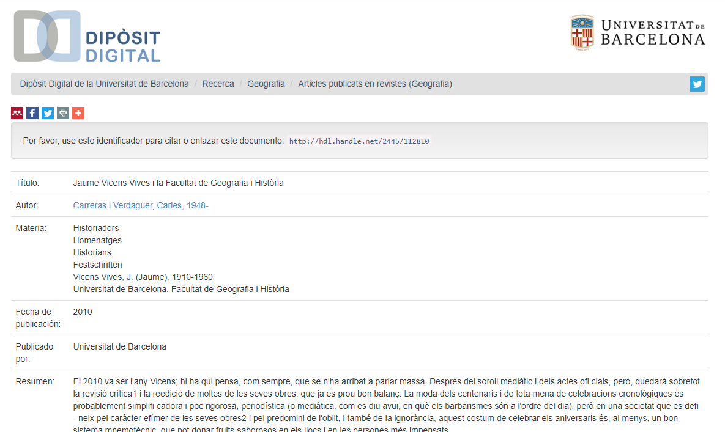
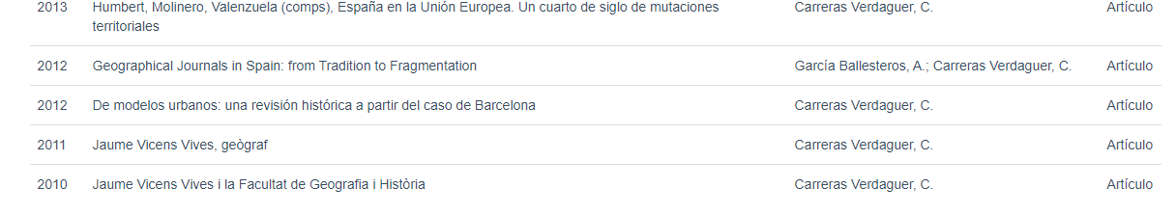
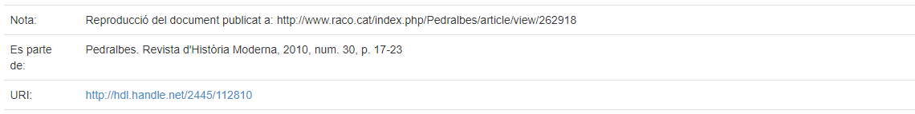
Catalonia research portal ... A new project helping to connect
Only researchers with ORCID in the CRIS appears in the portal
Professors UB : bases for a Linked Open Data project. Rosa Fabeiro I Anna Rovira
Authorities and Identifiers: How Do We Move Forward? An OCLC Research Symposium. Barcelona. 03/12/2019

Slide 5
We want ... Implement a Linked Open Data project
We have some bases and preparations done but we need:
A permanent URI for our authorities. Till now we depend on the SIGB
A vocabulary and format to move forward in a more interlinked ecosystem of bibliographic entities
A technological tool to do it possible and easily
At least ....
Professors UB : bases for a Linked Open Data project. Rosa Fabeiro I Anna Rovira
Authorities and Identifiers: How Do We Move Forward? An OCLC Research Symposium. Barcelona. 03/12/2019

Slide 6

Moltes gràcies!
© CRAI Universitat de Barcelona, curs 20xx-xx

