Slide 1
HAVING FUN WITH IDENTIFIERS
Ricardo
Santos
BNE
What I have learnt playing with them

Slide 2
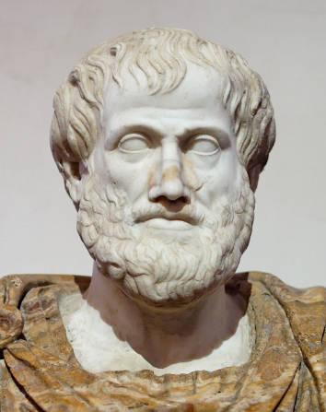




Free yourself from text constraints
What’s his name?
Ἀριστοτέλης
Aristòtil
Aristóteles
Aristotle

Slide 3
Free yourself from text constraints
What’s his name?
Ἀριστοτέλης
Aristòtil
Aristóteles
Aristotle
http://datos.bne.es/persona/XX4874856.html

Slide 4




Be likeable
Be linkable
?

Slide 5
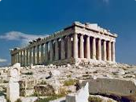
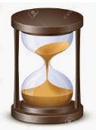

Identify
EVERYTHING

Slide 6
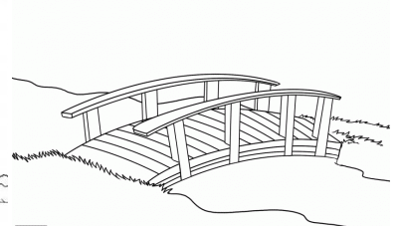
Use identifiers to exchange data
viaf
viaf

