Slide 1
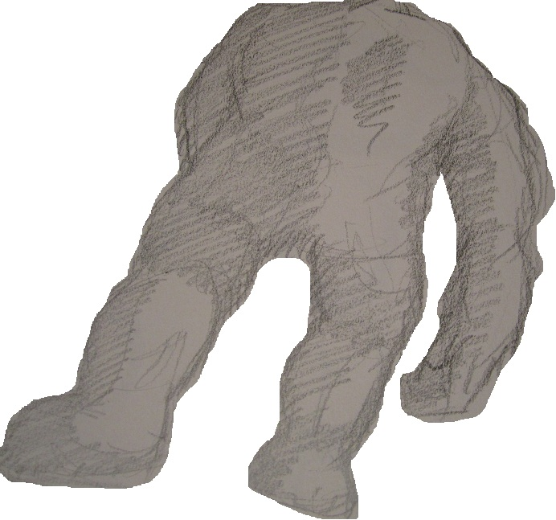
OCLC Research Library Partnership Work-in-Progress Webinar
A Glimpse of the
ILL Yeti:
Stalking the Big, Big Picture of System-wide Collection Sharing
Dennis Massie
Program Officer, OCLC Research
5 May 2015
Notes:
Thanks for joining me today on this foray into the wilds of resource sharing data analysis. I’ll spend the next 30 minutes or so telling you about some of my recent adventures on the trail of a possibly mythical creature, pictured here. Then we should have plenty of time at the end for questions and discussion. Full disclosure: the Yeti sketches in my presentation were created by my art student son, Bryan.

Slide 2
Today’s Stalking Itinerary
What’s an “ILL Yeti” anyway?
How the study came to be
Phase One: looking at the big picture
Current phase: going pixel (pixal?)
What comes next
Questions and discussion
Notes:
Here’s some idea of what to expect from me today. First we’ll go over the concept of the “ILL Yeti.” I’ll explain how the study I’m working on came about, report on some preliminary big-picture findings, and then talk about what I’ve been doing for the past few weeks – drilling down from the big picture, deep into the data, to take a close look at all the individual pixels. I do indeed know how to spell “pixels,” but the phrase “going pixel” of course put me in mind of “going postal,” and, well, you can see where things went from there. I’ll end up by talking about what remains to be gleaned from the data in my possession, and then, as promised, we can have some back and forth about the wacky world of collection sharing, the many numbers produced therein, and what we might hope to learn from them.

Slide 3
What’s an “ILL Yeti” anyway?
Notes:
First, let’s get this important question out of the way. What, in fact, is an ILL Yeti? On one level it’s a goofy metaphor I chose for this Webinar some weeks ago without thinking about the fact that “ILL” is technical jargon and might be confusing to someone who doesn’t sprekka da library lingie. I can tell you one thing that it isn’t…

Slide 4

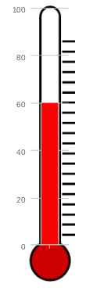
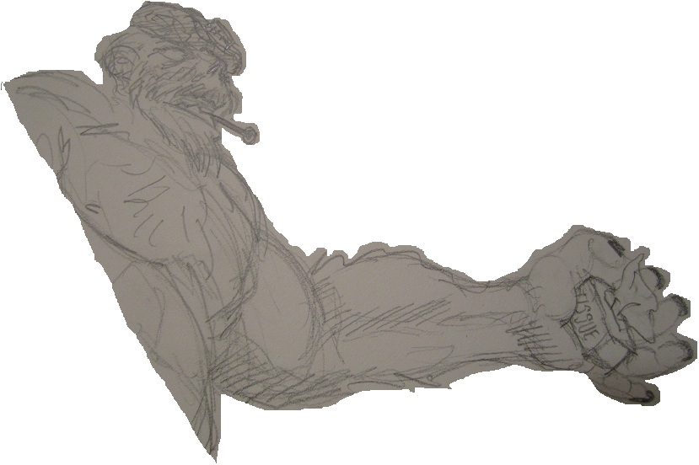

Not a sick Sasquatch
Notes:
The ILL yeti is not, in fact, ill. Nor is it dead, or dying, nor even particularly endangered. No, the ILL Yeti is elusive. Scarce. Hard to find, harder to track, maybe impossible to capture, notoriously shy and jealous of its privacy. Many of us hope to catch a glimpse of this magnificent creature and spend considerable chunks of our time working toward that goal. You can tell me at the end of the hour whether I’ve managed to provide a legitimate glimpse of the ILL Yeti to you on this day.

Slide 5
How the study came to be
Notes:
A few words about what set me on the trail of the ILL Yeti.

Slide 6

Current Interlending Landscape
Fragmented
  Many systems in play
Opaque
  Statistics reported in gross numbers
Evolving
  New models and methods emerging
Notes:
Most libraries, no matter what type – public, academic, government, special – are involved in multiple resource sharing consortia, with their ILL traffic passing through several different requesting and fulfillment systems. No one has access to all that collection sharing data from all those various systems.
All institutions that are members of the Association of Research Libraries report how many items they borrow through interlibrary loan each year, and how many items they supply.
But they send in one big number for the whole institution, with data gathered from every branch library and from every ILL system and mushed together – I believe that MUSHED is the correct technical term here – so that it’s really hard to make any sense out of what you’re looking at.

Slide 7
OCLC ILL statistics
 | FY13 | FY12 | FY11 | FY10 | FY09
ILL requests | 8,858,368 | 9,192,189 | 9,587,429 | 10,248,942 | 10,279,215
Year on year | 4% | 4% | 6% | 0.29%
Between FY09 and FY13, OCLC ILL has seen a 14% reduction in total number of ILL requests.
Anecdotal evidence tells us that US libraries are seeing an ongoing increase in their borrowing.
OCLC wants to learn more about various trends in fulfillment.
Notes:
My investigation got started because of a simple conversation between Katie Birch, a director of product management at OCLC, and OCLC’s chief strategist Lorcan Dempsey.
Katie mentioned in passing that, over the last few years, the volume of requests going through the OCLC ILL infrastructure has been on a slow but steady decline.
Lorcan was intrigued. He wanted to know if this was happening across all forms of collection sharing, in every corner of the ecosystem.
Katie shrugged and said, “I dunno.” Of such fateful encounters are grand and epic journeys born.

Slide 8
The Elusive Big Picture
Is resource sharing activity across the entire library community increasing, decreasing, or staying the same?
Are there similarities among those libraries where activity is decreasing, and among those where it is increasing?
What factors determine the selection of a model or method for each borrowing request?
Notes:
At other times such encounters result in small and rather interesting ILL studies. At Lorcan’s behest, Katie and I got together and decided we’d like nothing more than to find out the answers to these three questions.
One: Is ILL traffic overall going up, or is it going down?
Two: Are there any patterns or trends to be found among those libraries where the volume of traffic is increasing, or among those where it is decreasing?
And thirdly, what sort of thinking goes into the choice of a particular fulfillment system or venue for a particular request? Yes what I’ve just described is the elusive big picture of resource sharing – The ILL Yeti.
Have I mentioned that ILL data that presents a complete picture of any institution’s collection sharing activity is extremely hard to come by? I have?
Good.

Slide 9


Made up of 11 institutions with active, sophisticated, innovative resource sharing operations
Some long-established members, some newer members
Involved in all manner of consortial arrangements within and outside the group
Would serve as an excellent illustration of current trends in the research library community
Notes:
Enter the Borrow Direct consortium.
This group was an early adopter of what is known as the consortial borrowing model of sharing collections. You may also have heard of this model referred to as circ-to-circ or expanded circulation. What it means is that the group creates a virtual catalog that encompasses all their collections, and patrons of any of the institutions can search that catalog and request monographs from any of the other institutions. Unlike traditional interlibrary loan, which can take from one to three weeks if you’re talking about returnable items, these books requested via consortial borrowing tend to show up at the borrower’s library within two or three days. As you can imagine, this has been a very popular service with library patrons wherever it has been introduced.
Borrow Direct started out in 1999 with just three institutions – Yale, Columbia, and Penn. In 2002 they added four more partners – Brown, Cornell, Dartmouth and Princeton. More recently, in 2011, Harvard and MIT joined. University of Chicago joined in 2013,and just this past summer Johns Hopkins University signed up, bringing the total to eleven institutions. (Duke just joined within the past month but will not be part of the current study.)
To me, Borrow Direct seemed like a group whose overall collection sharing activity would provide a fascinating snapshot of what’s going on in the community, at least among large North American academic institutions. And, as it turned out, all eleven institutions were willing to provide the statistical data I need in order to conduct the analysis.
It would be a small sample, and not necessarily indicative of all types of libraries. But you have to start somewhere, and this seemed to me like just about the best start imaginable.

Slide 10
Phase One: looking at the big picture
Notes:
During the first part of the study I took in the view from 30,000 feet. After conferring with staff at the participating institutions, and with the Borrow Direct project manager, Peter Collins, I conducted a survey of what requesting and fulfillment venues each institution utilizes, what data each collects, and how they can slice it. Based on the survey responses, I created custom data intake spreadsheets for each institution, so all they had to do was plug their resource sharing numbers for the past five years into the appropriate boxes.

Slide 11
ARL ILL Stats for 11 BD Institutions
Filled Requests
Notes:
While I waited for the Borrow Direct institutions to gather and transmit their ILL data to me, I decided to check out the resource sharing activity they reported to the Association of Research Libraries for the past five years. Again, these statistics are reported as gross numbers – number of items borrowed, number of items loaned, without any sort of breakdown. The most recent figures available are from 2013. I knew that some of the Borrow Direct institutions had promised me data from 2009 through 2013, while others planned to deliver from 2010 through 2014. So, while the study covers five years, for the four years pictured here I knew that I would have data from all eleven institutions.
What does this chart show us? As a group, the Borrow Direct institutions lend a bit more than they borrow.
When you add the data for all eleven institutions together, the total volume went up twice in three tries, with a slight dip in 2012.
In 2013, for the first time, the group broke through the one million filled requests barrier – one million items borrowed and loaned, total for all eleven.
So far, it would seem that the answer to the question about ILL going up or down is a resounding “Going up!”

Slide 12
Our ILL Stats for 11 BD Institutions
Filled Requests
Notes:
In December I got my hands on five years’ worth of detailed ILL data from the eleven Borrow Direct institutions. Here’s what that looked like added all together.
The pattern is quite similar to what we saw with the gross ARL numbers: steady increase, slightly more lending than borrowing.
But there are two interesting differences in the data reported to me. One there is no dip in 2012 – the increase in ILL volume marches steadily uphill without interruption. Two, aside from 2012, the numbers reported to me are consistently a bit less than what was reported to ARL.

Slide 13
ARL vs Our Study
Why might the numbers differ?
Institutions with multiple libraries and with complex ILL set-up’s might not have reported all activity to us.
Both sets of data are self-reported, and possibly compiled by different people.
Potential fiscal/calendar confusion
Overall, study participants reported 97.9% of what was reported to ARL.
Notes:
Overall the numbers reported to ARL and to me were pretty close. Why would they be different? There are several possibilities, some listed here. This project was done on pretty short notice, on a quick timeframe, in the middle of the busiest time of the fall semester. So I asked folks pretty much to report those numbers on which they could readily lay their hands. I didn’t want to burden anyone with a big ILL statistics scavenger hunt. It struck me that it was far more important that each institution’s contribution to the data pool be consistent, representing the same set of activities for the same libraries every year. That appears to be what I got.
I should say that in an early version of a presentation on this topic, at ALA Midwinter, I reported a larger difference between what was reported to ARL and what was reported to me. This turned out to be an error on my part – an error not of math but of transcription from my worksheets to the slides.
Bottom line? Both sets of numbers – those reported to ARL, and those reported to me -- say the volume is going up.

Slide 14
Our Borrow Direct Numbers
(99.7% agreement between borr & lend)
Notes:
Still at 30,000 feet, I was eager to see what the numbers would look like when broken down by each of the requesting and fulfillment methods being used by the eleven institutions. A natural place to start was with the Borrow Direct consortial borrowing transactions.
A few things to remember here. One, Borrow Direct’s version of consortial borrowing handles only monographs. So all the numbers here represent returnable items.
Another thing to remember is that the Borrow Direct group added new members during the time depicted here – two in 2011, and another in 2013. So sure, we see the numbers are trending up. But is that because there is a bigger demand for resources by the patrons across the entire Borrow Direct partnership, or is the growth concentrated within the new members? More about that later.
You may notice that the line for borrowing appears to be missing. That’s because the third thing to remember about this chart is that Borrow Direct is a closed system, with all borrowing and lending taking place among the members, so when you gather all the data together and throw it onto a chart, borrowing and lending totals should match exactly. Which to my relief they pretty much did. The line isn’t blue or red – it’s purple, folks. Because the totals matched to the tune of 99.7%.
And once again – trending up!

Slide 15
Our OCLC Numbers
Filled Requests
Notes:
Next I looked at the OCLC ILL activity across the eleven Borrow Direct institutions. You’ll recall that Katie had noticed a 14% drop in the number of requests passing through the OCLC ILL system between 2009 and 2013, though she told me that folks at a number of big academics had mentioned their borrowing seemed to be going up.
The OCLC ILL numbers reported to me support Katie’s points to a large degree. Overall, with borrowing and lending added together, activity is rather flat, with a little spike in 2012 but then trending slightly downward.
When we separate the borrowing and lending activity, we see a sharp-ish decline in lending, from over 250,000 filled requests in 2010 to about 225,000 in 2013.
This is not quite offset by what looks to be a pretty steady rise in borrowing via OCLC ILL.
The two lines for borrowing and lending look like they might just meet and cross going in opposite directions in a few more years.

Slide 16
Our RapidILL Numbers
Filled Requests
Notes:
Next I compared the numbers of requests passing through the RAPID ILL system for this group. Nine of the eleven members of Borrow Direct report using RAPID.
RAPID ILL is a requesting and fulfillment method primarily for articles, or non-returnables. Institutions pay an annual fee to join and agree to provide copies from self-selected journal titles from their collections within 24 hours. Their holdings records are standardized so that the system will route requests only to those institutions that actually have the issue. It effectively automates the vast majority of routine copy requests, and the speed and fill rate are truly impressive.
It should be noted that RAPID ILL has recently added the functionality needed to request and deliver books. So it will be interesting to see if that does anything to reverse the pretty clear downward trend indicated here. Because after peaking in 2011, both borrowing and lending have been going down for the members of the Borrow Direct group. Again, this does not necessarily reflect the experiences of any other group of libraries. But among these eleven, there is a clear downturn, especially in lending,
One wonders if the proliferation of e-journals and increased availability of scholarly articles in full-text online is having an effect here.

Slide 17
Our Docline Numbers
Filled Requests
Notes:
Docline is an ILL system created and maintained by the National Library of Medicine. Like RAPIDILL, it is used primarily for articles, though a few book requests go through Docline.
Only five of the eleven Borrow Direct institutions reported using Docline. Borrowing is on a steady decline for those five, with lending in decline after peaking in 2011.
So – OCLC ILL, RAPID ILL, Docline – all forms of what one might call “traditional ILL” and all trending down. Only consortial borrowing, a fairly new model that essentially expands the traditional circulation function across multiple institutions, is trending up as a requesting and fulfillment venue among this group.
Overall collection sharing activity trending up, but now with an asterisk.

Slide 18
Proportion by Sharing Venue
(Other = Web form, ALA form, email, CCC, other circ-to-circ groups)
Notes:
This chart shows what part of the whole each requesting and fulfillment venue represents for the group overall, and then compares the earliest year for which I have data from everyone with the most recent year.
The first thing that jumps out is that Borrow Direct is growing in roughly the same proportion in which OCLC ILL is shrinking.
RAPID ILL and Docline also take up smaller pieces of the pie in 2013, with “Other” holding steady.
Note that “OTHER” includes consortial borrowing systems besides Borrow Direct. I’ll have more to say about this later.

Slide 19
Do you net lend or borrow, trend up or down?
All 11 BD institutions
Venue | 2010 | 2011 | 2012 | 2013
Overall
BD
OCLC
RapidILL
Docline
Other
= Net borrower
Trending up from previous year
= Net lender
Trending down from previous year
Notes:
This chart is an attempt to capture year-to-year trends overall and for each of the requesting and fulfillment venues, as well as whether as a group the Borrow Direct libraries were a net borrower or net lender within a particular venue in a given year. Light blue means net lender, gold means net borrower. Green stands for breaking even – remember, the Borrow Direct venue is a closed system where all the borrowing and lending is done by the 11 participants. I’ve put dark blue outlines around the arrows that are trending down only to make it easier for your eye to see the difference between the up’s and down’s of the same color. 2010 has all arrows pointing sideways, because I don’t have complete data for 2009 and thus can’t determine if the numbers for 2010 are trending up or down.
The chart reinforces some of the things we’ve already noted from our perch at 30,000 feet. The Borrow Direct group lends more than it borrows, in nearly every venue every year. Overall and Borrow Direct numbers are trending up; many of the numbers for the more traditional models of ILL are trending down. Note the changes in 2012 and 2013 in the Other category. The group has become a net borrower, and the numbers are trending up. More about that in a second.

Slide 20
BD, OCLC, and RAPID Comparison
Filled Requests
Notes:
This chart compares the numbers for the three most popular requesting and fulfillment venues used by the eleven Borrow Direct institutions, across the four years for which I have data from everyone.
Here you can see the trends and proportions very clearly. OCLC, in red, holding pretty steady, with a slight downturn in 2013. RAPID ILL, in green, peaking and then declining. Borrow Direct, in blue, growing steadily, and finally overtaking OCLC ILL as the most popular and prolific method in the most recent year.
But remember back a few slides ago, the two pie charts, where a little red slice of “OTHER” represented, among other things, additional consortial borrowing systems besides Borrow Direct? And remember the recent changes in the Other category on the chart with all the arrows?
Four of the eleven Borrow Direct institutions participate in multiple consortial borrowing systems. Two of them have joined other consortial borrowing arrangements since 2012. “Other” traffic is becoming something of a big deal within this group.

Slide 21
BD, Combined C2C, OCLC, and RAPID Comparison -- Filled Requests
Notes:
If we change our slide to include a bar that combines Borrow Direct numbers with all the other circ-to-circ traffic attributable to this group of eleven institutions – note the magenta bar in this new chart -- we see that circ-to-circ, or consortial borrowing, is growing even faster than we thought.
It overtakes OCLC ILL a year earlier than Borrow Direct by itself, and by 2013 the volume of consortial borrowing traffic for these eleven institutions towers over all the other methods, breaking the half-million-filled-request threshold.

Slide 22
Current phase: going pixel
Notes:
Now let’s go pixel, or get granular, or trade our Yeti-seeking telescope in for a microscope. Whatever metaphor you prefer for getting into the finer details and looking at the various parts in relation to the whole.

Slide 23
Total activity by date joined
Notes:
The questions get even more interesting as you dig more deeply.
For instance, here is an example of a real under-the-hood type of question. Is the growth in overall Borrow Direct activity happening across all eleven members, or is it mostly a product of introducing more partners into the mix?
To address that, I broke the overall numbers for all collection sharing activity into three groups – the three original Borrow Direct founders from 1999, the four institutions that joined in 2002, and the four new members who have come on board since 2011.
Here we see the overall activity for the original three Borrow Direct members – growing slightly , then flattening over the last couple of years.

Slide 24
Total activity by date joined
Notes:
Now we add in the overall ILL activity of the four institutions that joined Borrow Direct in 2002.
The shape of the line is almost identical to that of the three founders, but a tick less each year.

Slide 25
Total activity by date joined
Notes:
Now add in the third group, those four institutions that have joined since 2011. Remember, one joined in 2014, so any effect of their joining won’t be reflected on this slide.
The most obvious and striking thing about this chart is the sharp increase in activity among the newest group, almost catching up to the other two by 2013. Clearly, having a couple of those institutions join Borrow Direct in 2011 had a momentous impact on the overall lending and borrowing volume for those institutions.
This chart would seem to suggest that the growth in overall activity is limited mostly to the new members, and consortial borrowing accounts for most if not all of it.

Slide 26
ARL vs Our Study
Why might the numbers differ?
Institutions with multiple libraries and with complex ILL set-up’s might not have reported all activity to us.
Both sets of data are self-reported, and possibly compiled by different people.
Potential fiscal/calendar confusion
Overall, study participants reported 97.9% of what was reported to ARL.
Notes:
Remember this slide from the top of the program? How, overall, the 11 Borrow Direct institutions reported nearly the identical numbers to me that they reported to ARL for those same years?
One of the effects of drilling down into the data is to reveal that, in spite of the apparent match with the numbers previously reported, there is a great deal of diversity to be found by examining each institution’s numbers in turn.

Slide 27
% ARL Numbers Reported to Us
Notes:
For instance, this scatter chart shows just how much the responses diverged from each other.
The chart depicts for each institution what percentage of their ARL-reported borrowing and lending numbers were reported to me. Within the red circle are 5 institutions whose responses were very close to what they reported to ARL, including one that aced the exercise – 100% by 100%. The green circle contains 2 more institutions that weren’t all that far off of what they reported to ARL. The blue triangle contains 3 institutions that reported significantly higher numbers to me than they did to ARL; this was unexpected and bears some looking into. And finally in the middle of the big rectangle is a single institution that reported considerably less than what was reported to ARL. This was not unexpected but rather a conscious decision by staff at that institution to report only the activity of the main library, not the many branches, which would have been too tall of an order for the short data-gathering window we had to work with. The takeaway from this slide is simply that there is more complexity hidden within the numbers than you might at first imagine, and that I need to spend some time investigating the variances to make sure they don’t undermine any of the conclusions that the data seems to suggest.

Slide 28
% ARL Reported, by “Era” Group
Notes:
Here’s another way to look at the data about which institutions reported what percentage of their previously-reported ARL figures.
I’ve broken the reporting percentages into the same three groups we used to look at overall resource sharing activity a few slides ago – the three original founding members of the Borrow Direct consortium, the four institutions that joined in 2002, and the four new ones that have come on board since 2011. When looked at through this prism, the only variance that really sticks out is the percentage reported in 2012 by the three original founding members. This suggests that a closer look at the data behind those numbers would be worth the effort.
I will also be querying all the participants with various types of questions that arise as I look through the individual sets of data.

Slide 29
Do you net lend or borrow, trend up or down?
All 11 BD institutions
Venue | 2010 | 2011 | 2012 | 2013
Overall
BD
OCLC
Rapid
Docline
Other
= Net borrower
Trending up from previous year
= Net lender
Trending down from previous year
Notes:
You no doubt remember this chart with all the pretty arrows. Breaking this report into the three groups was another way to reveal some stark differences lying just beneath the surface of this seemingly homogenous set of resource sharing partners.
Once again, this version of the chart the results for all eleven institutions. In the aggregate, they are net lenders. Overall numbers and Borrow Direct numbers are trending up. By 2012 most of the more traditional methods of resource sharing are trending down.

Slide 30
Do you net lend or borrow, trend up or down?
3 “founding” institutions
Venue | 2010 | 2011 | 2012 | 2013
Overall
BD
OCLC
Rapid
Docline
Other
= Net borrower
Trending up from previous year
= Net lender
Trending down from previous year
Notes:
This represents the same snapshot for just the three original founding members of the Borrow Direct consortium. Aside from on OCLC, the data for these institutions aggregates as net borrowers. Even in the overall category, for the most recent numbers for this group shows a downward trend.

Slide 31
Do you net lend or borrow, trend up or down?
4 “joined in 2002” institutions
Venue | 2010 | 2011 | 2012 | 2013
Overall
BD
OCLC
Rapid
Docline
Other
= Net borrower
Trending up from previous year
= Net lender
Trending down from previous year
Notes:
Moving on to the four institutions that joined in 2002 – this group more closely reflects the snapshot for the whole group of 11 members. More net lending, more trending up in various categories. But again, just as with the group of three founding libraries, overall in 2013 the numbers are trending down.

Slide 32
Do you net lend or borrow, trend up or down?
4 “newbie” institutions
Venue | 2010 | 2011 | 2012 | 2013
Overall
BD | ----
OCLC
Rapid
Docline
Other
= Net borrower
Trending up from previous year
= Net lender
Trending down from previous year
Notes:
Finally, the snapshot for the four Borrow Direct members who joined from 2011 through 2014. No activity in the Borrow Direct venue for 2010, of course. Much net lending and upward trending across the board. Downward trending in RapidILL and Docline for the past couple of years.
The new kids at the ball appear to be providing the growth. Among this group, even OCLC ILL activity is up across the board.

Slide 33
What comes next…
Notes:
That’s kind of where I am as of today, as far as things I can report out. Here’s a preview of what remains to be done.

Slide 34
Next Steps
Individual profiles for all 11 institutions
Look for cause and effect
Seek insight into strategic thinking
Break down returnables versus nonreturnables
Look at fill rates
Track reciprocal interactions via OCLC ILL
Report out generically
Report to BD cohort in detail
Repeat study with CIC (this time with POD)
Notes:
I’ve spent April designing individual snapshots comparing each institution’s numbers with the group averages, and then posing questions based on what I’m seeing in the data. Those reports are about to go out to the Borrow Direct institutions.
Some of the questions will seek to get at the underlying causes for changes in the trends over time; some will ask about the thinking behind joining a particular consortial group or sending a particular request through a particular venue rather than other. I really feel like the insight gained from going back to the Borrow Direct ILL staff with questions may end up being the most interesting output of the study. Already I’ve been talking with some of them. An ILL person from Penn was quite eloquent about ILL processes having grown to be very efficient. ILL departments are delivering a lot more material these days from their own collections, because the technology has gotten better at catching ILL requests for materials already owned. This alone, the Penn person pointed out, could account for a 10-to-15% drop in borrowing every year. I can hardly wait to speak with the other ILL folks.
I may spend some time on fill rates and returnables vs non-returnables, if that is of interest to the ILL staffers. I especially want to look closely at how each member of the group interacted with the others via OCLC ILL and track how that changed as more institutions joined Borrow Direct.
When this project is finished, there may be other questions to pursue with more detailed data, such as tracking what sorts of material is being loaned via the various methods, both within and outside the group. And since this is a small, unscientific sample, it may be worth doing this same analysis with data from other groups and other types of libraries. I have a solid commitment from the CIC libraries to take part in an extension of this study, and they want to track some additional data points such as purchase on demand.

Slide 35

Are we there Yet(i)?
Notes:
We’ve come to the end of my prepared remarks. Let’s do a quick recap of what seems to be indicated by this small but hopefully representative pool of collection sharing data.
There seem to be two main findings.
One, according to the numbers from the Borrow Direct group, traditional ILL seems to be slightly on the decline, at least among these highly active libraries. Two, consortial borrowing is growing, and at a steep rate – but much of that growth may be due to more institutions getting involved with using that particular sharing model.
What I’m not sure about is the WHY.
What will follow-up interviews with Borrow Direct ILL staffers reveal? Will have to wait and see. After all, this IS a work in progress.
In the meantime, what do you think? Am I on target about the WHAT? Do you have opinions about the WHY? And did you catch a glimpse today of the ILL Yeti? Did you see even a shadow of the big, big picture of system-wide collection sharing, enough to be able to picture what that must be like?

Slide 36

Questions?
Comments?
Notes:
Please share your questions and comments. And thanks for listening!

Slide 37
Thanks for participating!
Dennis Massie
massied@ococ.org

